Slide 1
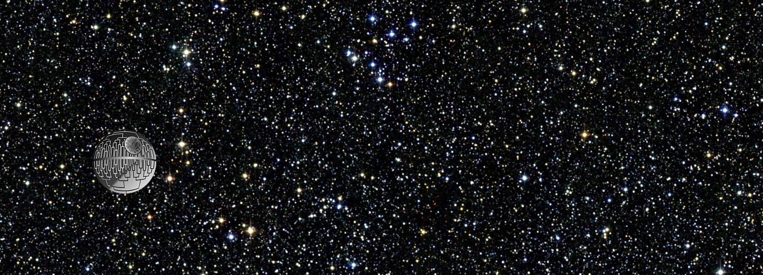

Phylo Seminar 2024

Slide 2
Talking tree

Slide 3
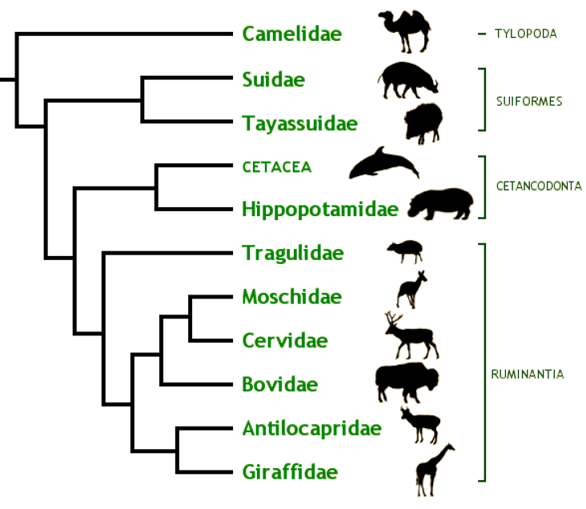
Talking/reading “tree”: Tree Thinking
Phylogenies are cartoons/graphs/simplifications showing the pattern of relationship among the sampled tips
Critical terms/concepts:
Most recent common ancestor
Closest relative (“sister group”)
Clade, monophyletic
Cladogram vs phylogram vs chronogram
Ancestral vs derived characters
Primitive lineage fallacy (sampling, extinction, etc…)

Slide 4
Talking/reading “tree”: Tree Thinking
Phylogenies are cartoons/graphs/simplifications showing the pattern of relationship among the sampled tips
Critical terms/concepts:
Most recent common ancestor
Closest relative (“sister group”)
Clade, monophyletic
Cladogram vs phylogram vs chronogram
Ancestral vs derived characters
Primitive lineage fallacy (sampling, extinction, etc…)

Slide 5
Talking/reading “tree”: Tree Thinking
Phylogenies are cartoons/graphs/simplifications showing the pattern of relationship among the sampled tips
Critical terms/concepts:
Most recent common ancestor
Closest relative (“sister group”)
Clade, monophyletic
Cladogram vs phylogram vs chronogram
Ancestral vs derived characters
Primitive lineage fallacy (sampling, extinction, etc…)

Slide 6
Talking/reading “tree”: Tree Thinking
Phylogenies are cartoons/graphs/simplifications showing the pattern of relationship among the sampled tips
Critical terms/concepts:
Most recent common ancestor
Closest relative (“sister group”)
Clade, monophyletic
Cladogram vs phylogram vs chronogram
Ancestral vs derived characters
Primitive lineage fallacy (sampling, extinction, etc…)

Slide 7
Talking/reading “tree”: Tree Thinking
Phylogenies are cartoons/graphs/simplifications showing the pattern of relationship among the sampled tips
Critical terms/concepts:
Most recent common ancestor
Closest relative (“sister group”)
Clade, monophyletic
Cladogram vs phylogram vs chronogram
Ancestral vs derived characters
Primitive lineage fallacy (sampling, extinction, etc…)

Slide 8
Talking/reading “tree”: Tree Thinking
Phylogenies are cartoons/graphs/simplifications showing the pattern of relationship among the sampled tips
Critical terms/concepts:
Most recent common ancestor
Closest relative (“sister group”)
Clade, monophyletic
Cladogram vs phylogram vs chronogram
Ancestral vs derived characters
Primitive lineage fallacy (sampling, extinction, etc…)

Slide 9
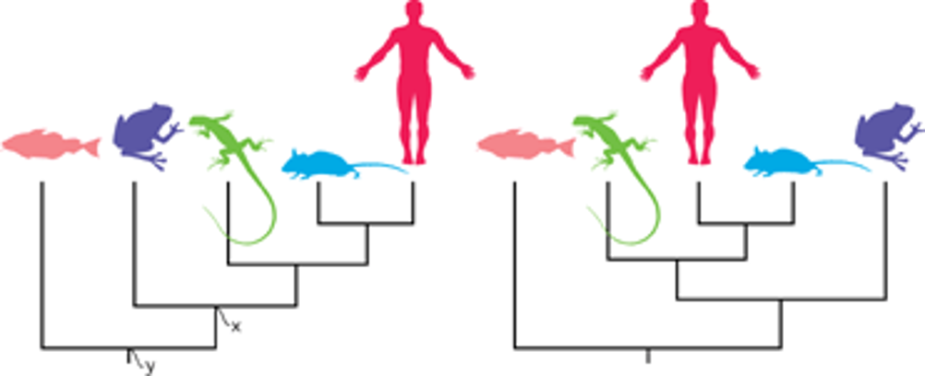
Talking/reading “tree”: Tree Thinking
From Baum, Smith, and Donovan: The Tree-thinking Challenge

Slide 10
Talking/reading “tree”: Tree Thinking
From Baum, Smith, and Donovan: The Tree-thinking Challenge

Slide 11
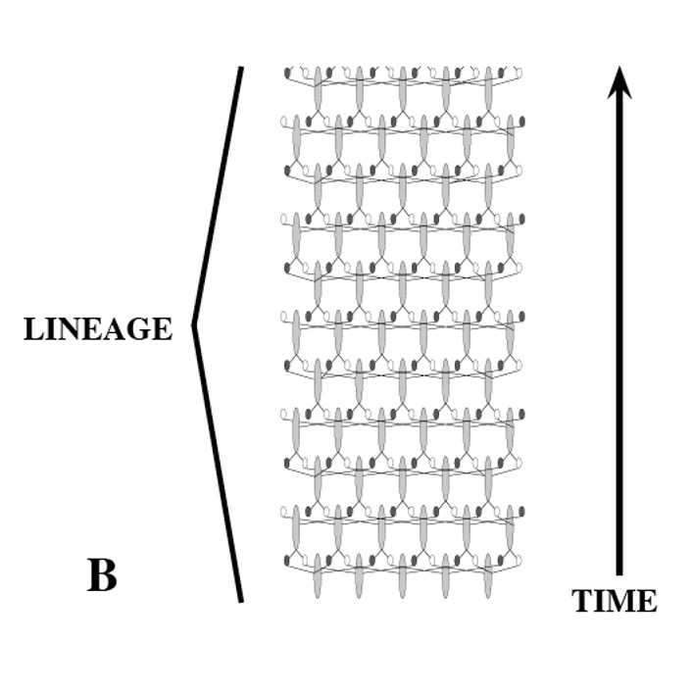
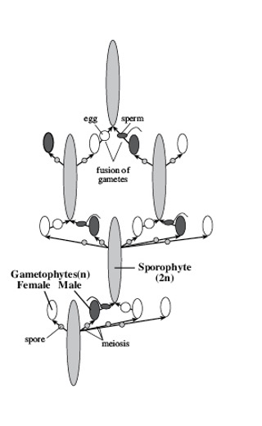
The lines (branches) on a phylogeny …
… represent lineages, sequences of ancestral-descendent populations through time

Slide 12
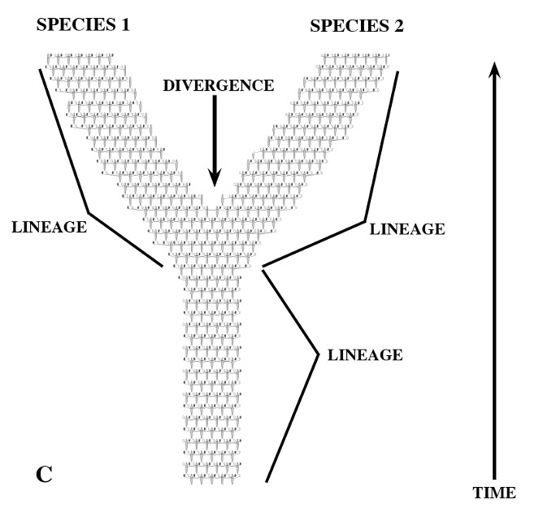
The lines (branches) on a phylogeny …
… represent lineages, sequences of ancestral-descendent populations through time

Slide 13
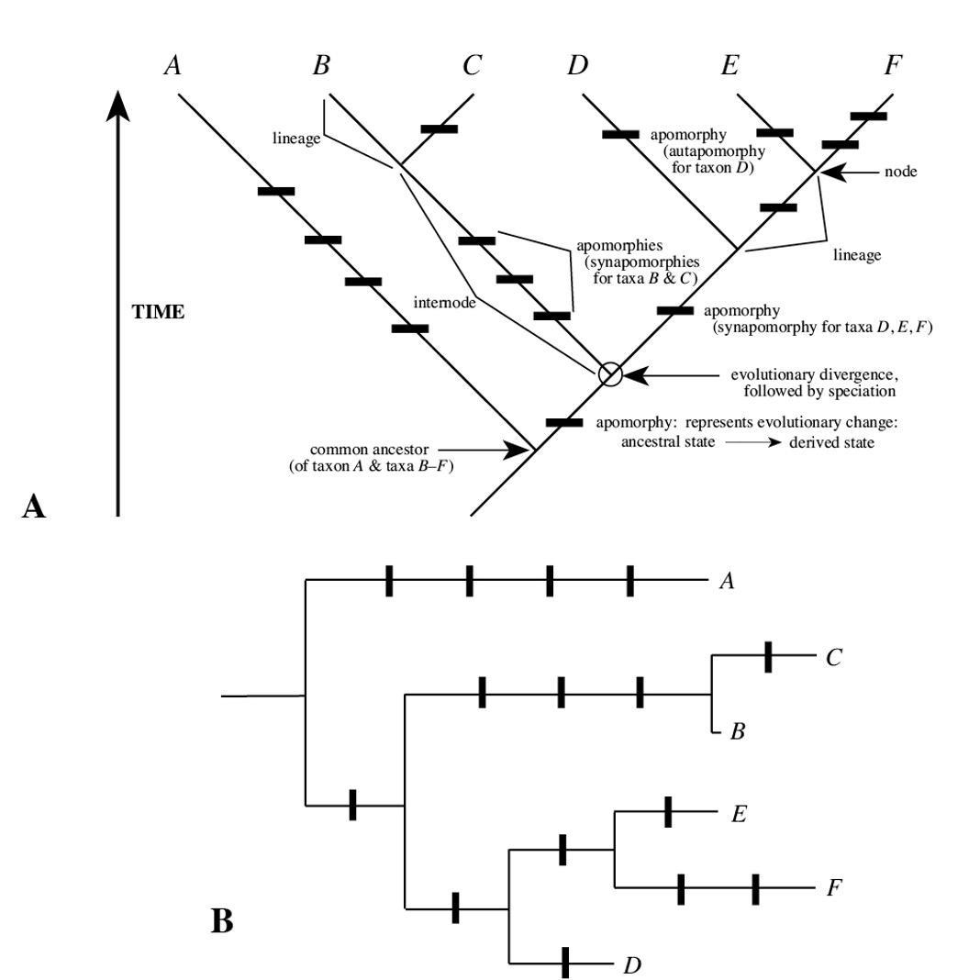
Trees and characters

Slide 14
Trees and characters

Slide 15
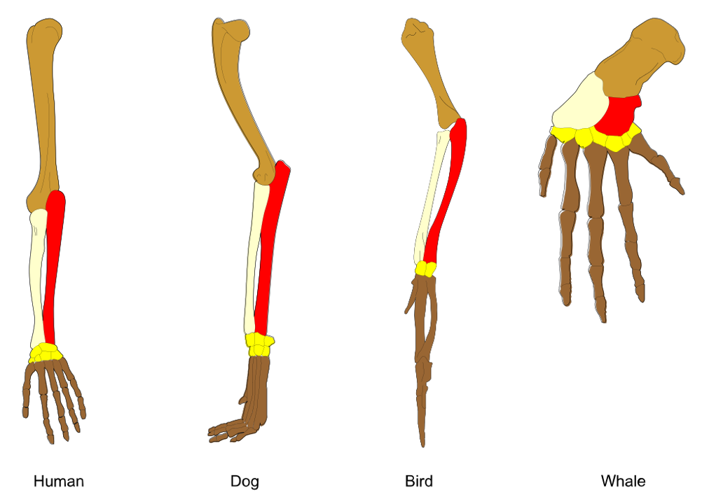
Homology
Homology is similarity due to common ancestry. Two features are said to be homologous if they are derived from the same feature in a common ancestor.
Homologous feature = “character” = something that has information about evolutionary relationships = something that we can use to infer phylogeny

Slide 16
Homology
Homology is similarity due to common ancestry. Two features are said to be homologous if they are derived from the same feature in a common ancestor.
Homologous feature = “character” = something that has information about evolutionary relationships = something that we can use to infer phylogeny

Slide 17
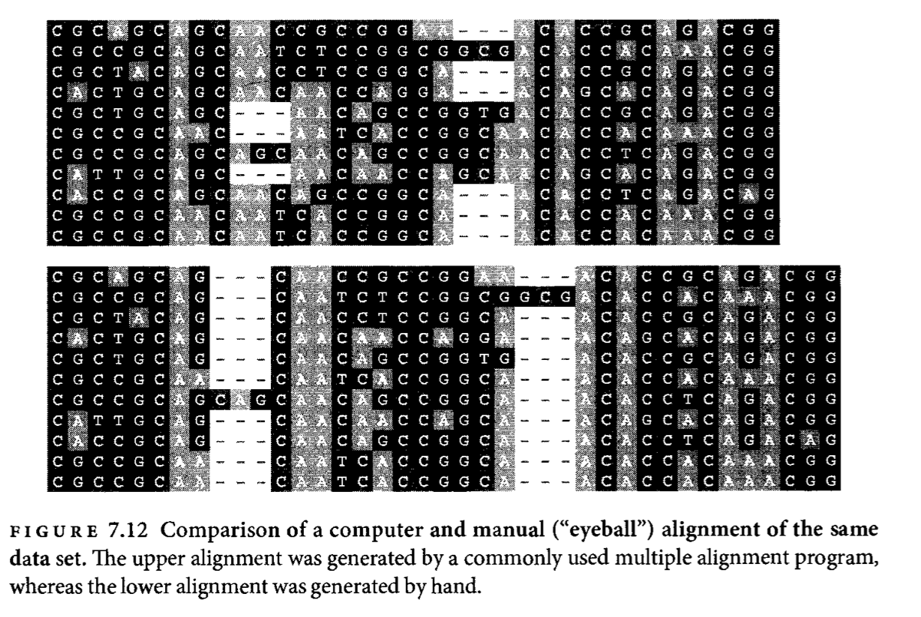
Molecular data
Characters and homology in molecular data
It’s all about the alignment

Slide 18
Tree inference: Parsimony

Slide 19
Parsimony
The maximum parsimony criterion: The best tree is the one that requires the fewest character-state changes to explain the data
Multiple equally parsimonious trees are possible for any given dataset, each of which will differ in the location of the inferred changes (but not their number)… AccTrans vs DelTran

Slide 20
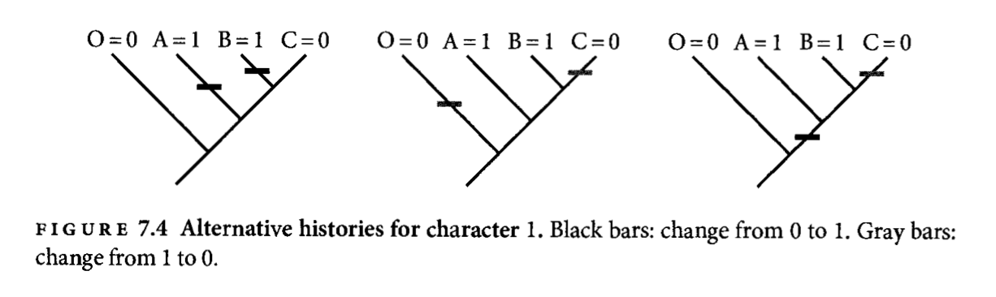
Parsimony
The maximum parsimony criterion: The best tree is the one that requires the fewest character-state changes to explain the data
Multiple equally parsimonious trees are possible for any given dataset, each of which will differ in the location of the inferred changes (but not their number)… AccTrans vs DelTran

Slide 21
Parsimony
Even when we have a clear way to decide which tree is better, there are A LOT of possible trees that we would have to check
Idea of “tree space”

Slide 22
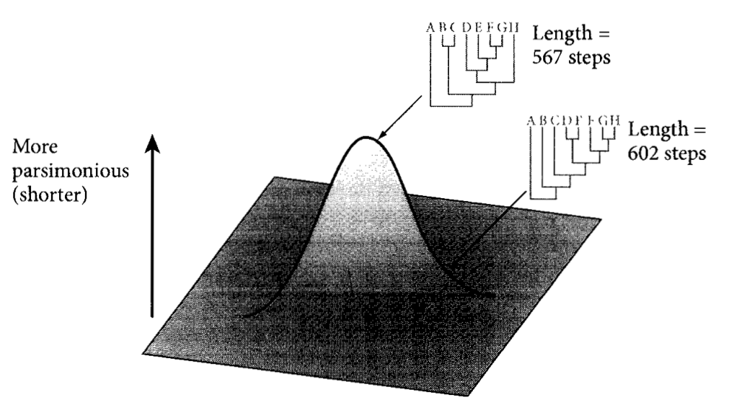
Parsimony
Even when we have a clear way to decide which tree is better, there are A LOT of possible trees that we would have to check
Idea of “tree space”

Slide 23
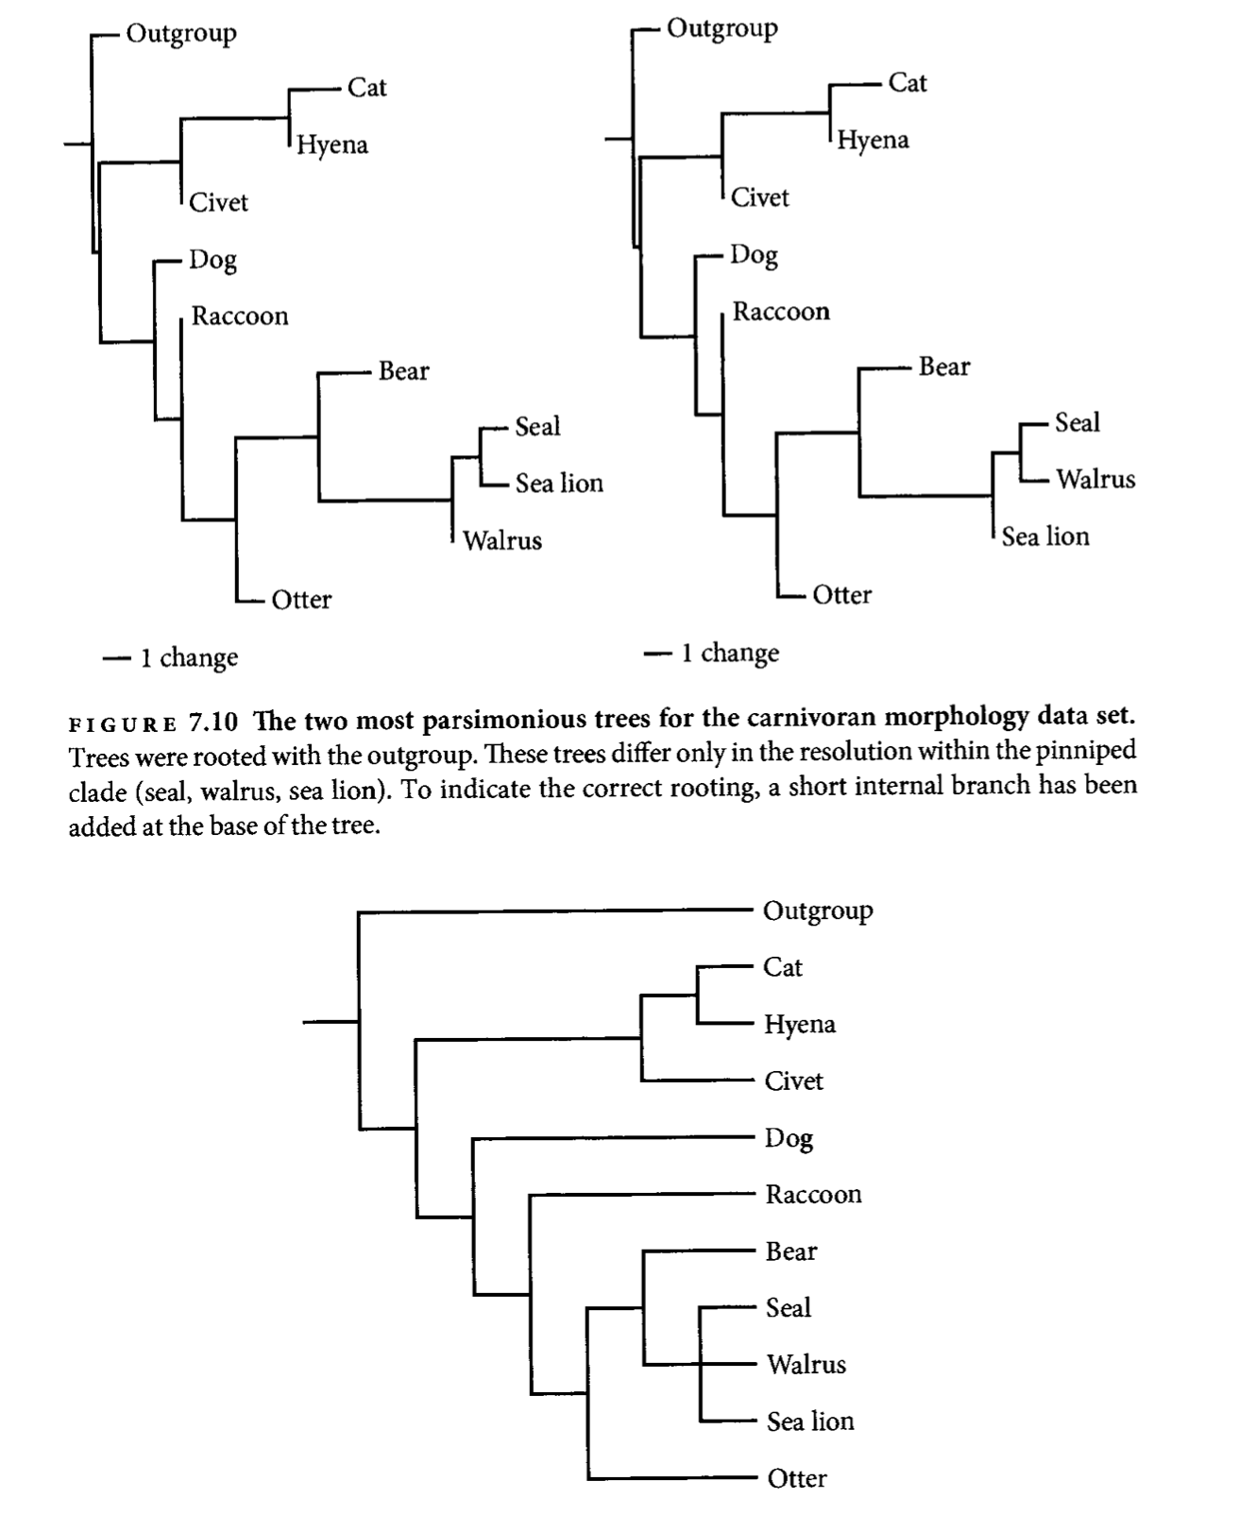
Parsimony
Issues and concerns
What do branch lengths indicate in a parsimony-based phylogram? (And what is a consensus tree?)

Slide 24
Parsimony
Issues and concerns
What do branch lengths indicate in a parsimony-based phylogram? (And what is a consensus tree?)

Slide 25
Parsimony
Issues and concerns
What do branch lengths indicate in a parsimony-based phylogram? (And what is a consensus tree?)
Parsimony assumes that character-state change is very slow
How do we do tests? (This is the most parsimonious tree, but is it meaningfully better than the next best tree?)
What can we learn about the process generating our data?

Slide 26
Parsimony
Issues and concerns
What do branch lengths indicate in a parsimony-based phylogram? (And what is a consensus tree?)
Parsimony assumes that character-state change is very slow
How do we do tests? (This is the most parsimonious tree, but is it meaningfully better than the next best tree?)
What can we learn about the process generating our data?

Slide 27
Parsimony
Issues and concerns
What do branch lengths indicate in a parsimony-based phylogram? (And what is a consensus tree?)
Parsimony assumes that character-state change is very slow
How do we do tests? (This is the most parsimonious tree, but is it meaningfully better than the next best tree?)
What can we learn about the process generating our data?

Slide 28
Tree inference: ML

Slide 29
Likelihood
What is “maximum likelihood”?
Maximum likelihood seeks to find the tree (and other values of model parameters) that makes the observed data the most probable

Slide 30
Likelihood
What is “maximum likelihood”?
Maximum likelihood seeks to find the tree (and other values of model parameters) that makes the observed data the most probable
The likelihood of the model is the probability of the data given that model
(a particular set of model parameter values—including a phylogeny and all its branch lengths—has a particular probability of producing your data, e.g., your sequence alignment)

Slide 31
Likelihood
What is “maximum likelihood”?
Maximum likelihood seeks to find the tree (and other values of model parameters) that makes the observed data the most probable
The likelihood of the model is the probability of the data given that model
(a particular set of model parameter values—including a phylogeny and all its branch lengths—has a particular probability of producing your data, e.g., your sequence alignment)

Slide 32
Likelihood
What is “maximum likelihood”?
Maximum likelihood seeks to find the tree (and other values of model parameters) that makes the observed data the most probable
The likelihood of the model is the probability of the data given that model
(a particular set of model parameter values—including a phylogeny and all its branch lengths—has a particular probability of producing your data, e.g., your sequence alignment)
(think about coin-flipping)

Slide 33
Likelihood
What is a phylogenetic “model”?
A model is simply a mathematical description of the processes generating the data.
So, for example, one might model DNA sequences as evolving along a phylogeny, with a particular rate that A’s change to T’s, etc.

Slide 34
Likelihood
What is a phylogenetic “model”?
A model is simply a mathematical description of the processes generating the data.
So, for example, one might model DNA sequences as evolving along a phylogeny, with a particular rate that A’s change to T’s, etc.

Slide 35
Likelihood
Markov model
A Markov model is one where the state at the next step depends only on the current state. I.e., the model has no “memory"
E.g., the probability of throwing a head or tail in a coin toss is independent of whether the last throw was a head or tail

Slide 36
Likelihood
Markov model
A Markov model is one where the state at the next step depends only on the current state. I.e., the model has no “memory"
E.g., the probability of throwing a head or tail in a coin toss is independent of whether the last throw was a head or tail
Generally, we use continuous-time Markov models, or “continuous-time Markov chains” (CTMCs)

Slide 37
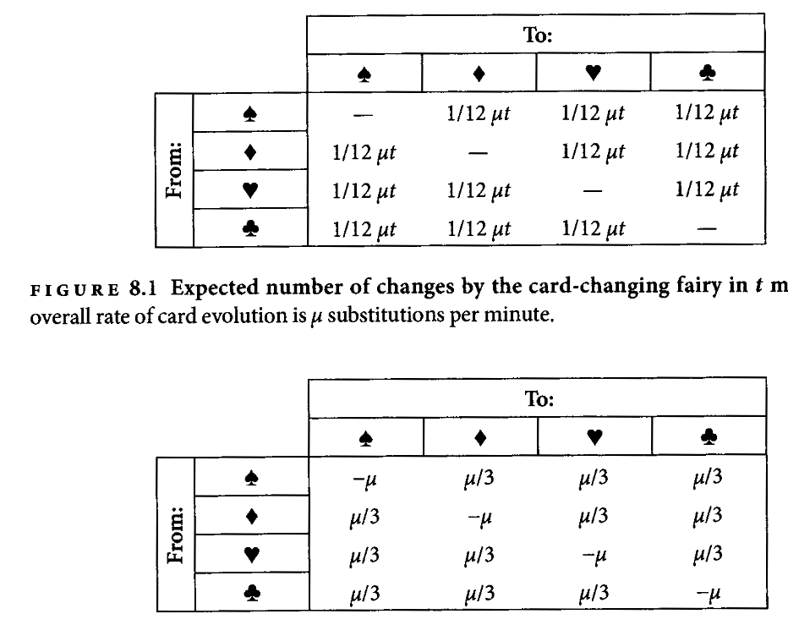
Likelihood
The substitution fairy that switches a card to another card at a constant (average) rate
The number of changes over time t:

Slide 38
Likelihood
Substitution models
Substitution models describe the process of substitutions (changes in a sequence of, e.g., nucleotides): what are the rates of change, and from that, what is the instantaneous rate matrix

Slide 39
Likelihood
The substitution fairy that switches a card to another card at a constant (average) rate
The (instantaneous) rates of change:
(This is a convenient fairy with a convenient deck: all the suits are present in the same frequency, and the fairy picks a card from the deck at random)

Slide 40
Likelihood
The substitution fairy that switches a card to another card at a constant (average) rate
The (instantaneous) rates of change:
(This is a convenient fairy with a convenient deck: all the suits are present in the same frequency, and the fairy picks a card from the deck at random)
The all-powerful “Q-matrix”

Slide 41
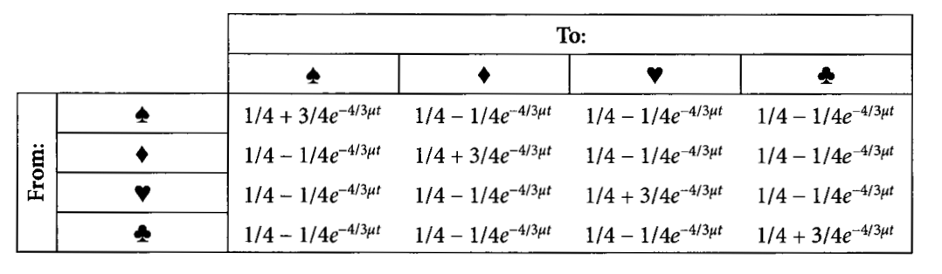
Likelihood
The substitution fairy that switches a card to another card at a constant (average) rate
The corresponding probability matrix:
(We’ll ignore how we get to this for now)
(ut is the rate times the time – ie, the branch length)

Slide 42
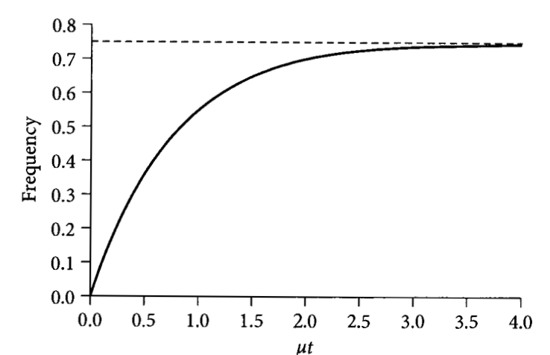
Likelihood
The substitution fairy that switches a card to another card at a constant (average) rate
The frequency of differences in two sequences as a function of the distance
Why does this curve flatten out?
Why at .75?

Slide 43
Likelihood
The substitution fairy that switches a card to another card at a constant (average) rate
The frequency of differences in two sequences as a function of the distance
Why does this curve flatten out?
Why at .75?

Slide 44
Likelihood
The substitution fairy that switches a card to another card at a constant (average) rate
The frequency of differences in two sequences as a function of the distance
Why does this curve flatten out?
Why at .75?
(“multiple hits”, “saturation”)

Slide 45
Ack, probability theory
Slide courtesy of John Huelsenbeck

Slide 46
Ack, probability theory
Slide courtesy of John Huelsenbeck

Slide 47
Ack, probability theory
Slide courtesy of John Huelsenbeck

Slide 48
Ack, probability theory
Slide courtesy of John Huelsenbeck

Slide 49
Ack, probability theory
Slide courtesy of John Huelsenbeck

Slide 50
Ack, probability theory
Slide courtesy of John Huelsenbeck

Slide 51
Ack, probability theory
Slide courtesy of John Huelsenbeck

Slide 52
Ack, probability theory
Slide courtesy of John Huelsenbeck

Slide 53
Ack, probability theory
Slide courtesy of John Huelsenbeck

Slide 54
Ack, probability theory
(Exponentially-distributed random variables are counter-intuitive—the amount of time you wait for the next event is not influenced by the amount of time that you have been waiting already)
Slide courtesy of John Huelsenbeck

Slide 55
Ack, probability theory
(Exponentially-distributed random variables are counter-intuitive—the amount of time you wait for the next event is not influenced by the amount of time that you have been waiting already)
(Also, if two types of events can happen, one with rate x and one with rate y, the waiting time to the next event (the sojourn time) is exponentially distributed with rate x+y)
Slide courtesy of John Huelsenbeck

Slide 56
Ack, probability theory
Tangent;
Slide courtesy of John Huelsenbeck

Slide 57
Ack, probability theory
Slide courtesy of John Huelsenbeck

Slide 58
Ack, probability theory
Slide courtesy of John Huelsenbeck

Slide 59
Ack, probability theory
Tangent;
Slide courtesy of John Huelsenbeck

Slide 60
Ack, probability theory
Tangent;
Slide courtesy of John Huelsenbeck

Slide 61
Example
Learning by simulation
Slide courtesy of John Huelsenbeck

Slide 62
Example
Learning by simulation
Our handy instantaneous-rate matrix:
Slide courtesy of John Huelsenbeck

Slide 63
Example
Learning by simulation
Slide courtesy of John Huelsenbeck

Slide 64
Example
Learning by simulation
Slide courtesy of John Huelsenbeck

Slide 65
Example
Learning by simulation
Slide courtesy of John Huelsenbeck

Slide 66
Example
Learning by simulation
Slide courtesy of John Huelsenbeck

Slide 67
Example
Learning by simulation
Slide courtesy of John Huelsenbeck

Slide 68
Example
Learning by simulation
Slide courtesy of John Huelsenbeck

Slide 69
Example
Learning by simulation
Slide courtesy of John Huelsenbeck

Slide 70
Example
Learning by simulation
So given a model (a Q-matrix), we can simulate character histories
And conversely, we can calculate the probability of any particular end state given a starting state (don’t worry about how we do this-–at this stage I just want you to have an intuition for why it should be possible)
Slide courtesy of John Huelsenbeck

Slide 71
Example
Learning by simulation
So given a model (a Q-matrix), we can simulate character histories
And conversely, we can calculate the probability of any particular end state given a starting state (don’t worry about how we do this-–at this stage I just want you to have an intuition for why it should be possible)
Slide courtesy of John Huelsenbeck

Slide 72
Example
Learning by simulation
So given a model (a Q-matrix), we can simulate character histories
And conversely, we can calculate the probability of any particular end state given a starting state (don’t worry about how we do this-–at this stage I just want you to have an intuition for why it should be possible)
Slide courtesy of John Huelsenbeck

Slide 73
Tree inference: ML II
How do the computers actually do this?

Slide 74
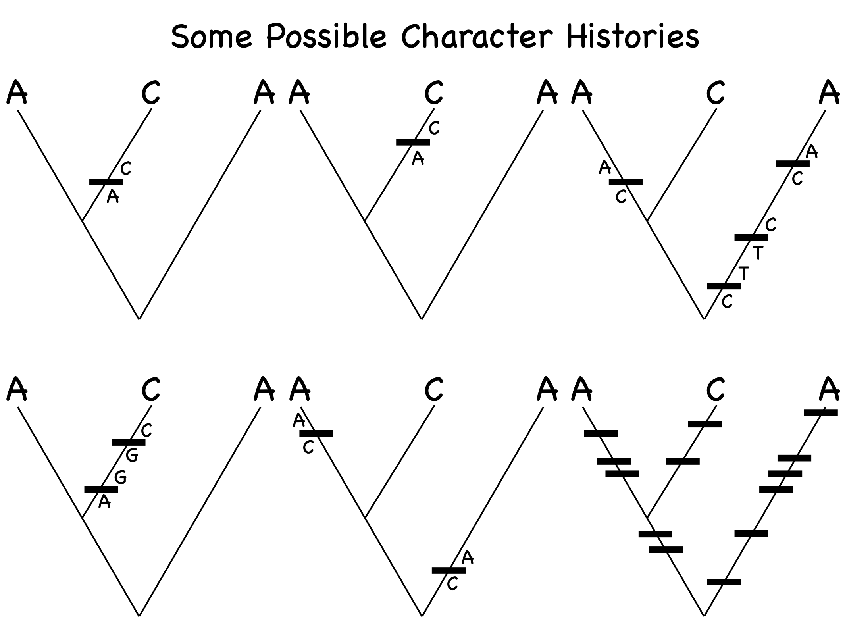
The two great (math) tricks that make it all possible
Problem One: There are an infinite number of possible histories along a branch—e.g., it could have started as an A, switched to a G, and then switched to a T, or it could have …—how can we calculate the probability of any particular end state?
Trick One: Matrix exponentiation!
Slide courtesy of John Huelsenbeck

Slide 75
The two great (math) tricks that make it all possible
Problem One: There are an infinite number of possible histories along a branch—e.g., it could have started as an A, switched to a G, and then switched to a T, or it could have …—how can we calculate the probability of any particular end state?
Trick One: Matrix exponentiation!

Slide 76
So, for a given branch and substitution rate, we can calculate the probability of each of the possible states at the end of the branch, for each of the states at the beginning of the branch

Slide 77
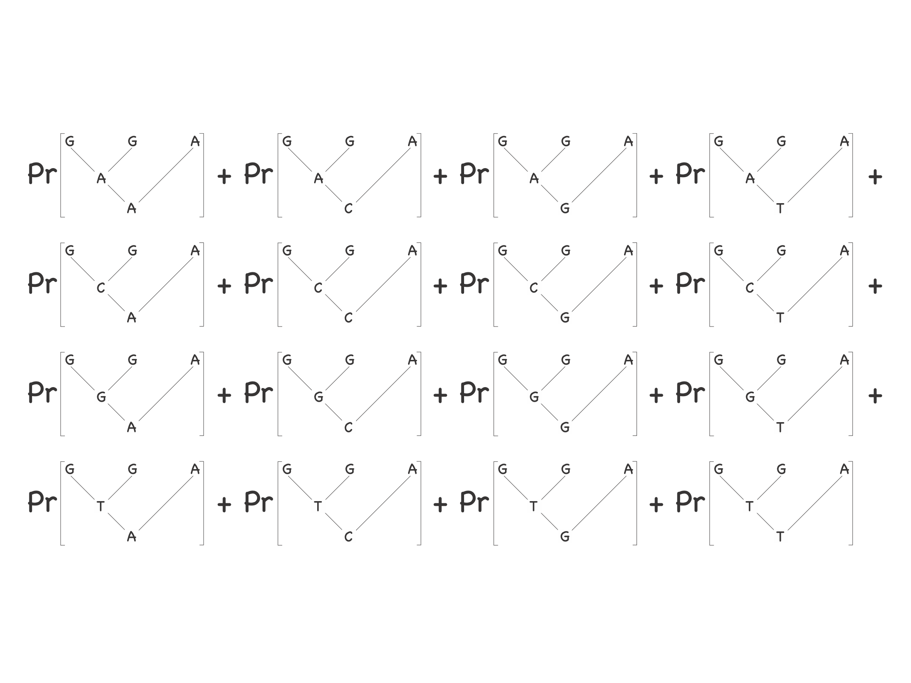
The two great (math) tricks that make it all possible
Problem Two: The number of different possible combinations of states at the internal nodes of a tree of n species is 4^{(n-1).} This is a very big number for any even moderately sized tree! Given that we don’t know what these internal states are, how can we average over all of them?
Trick Two: The pruning algorithm!

Slide 78
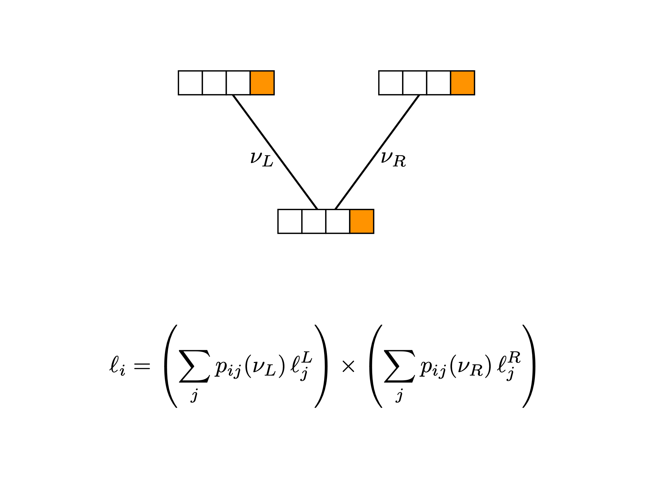
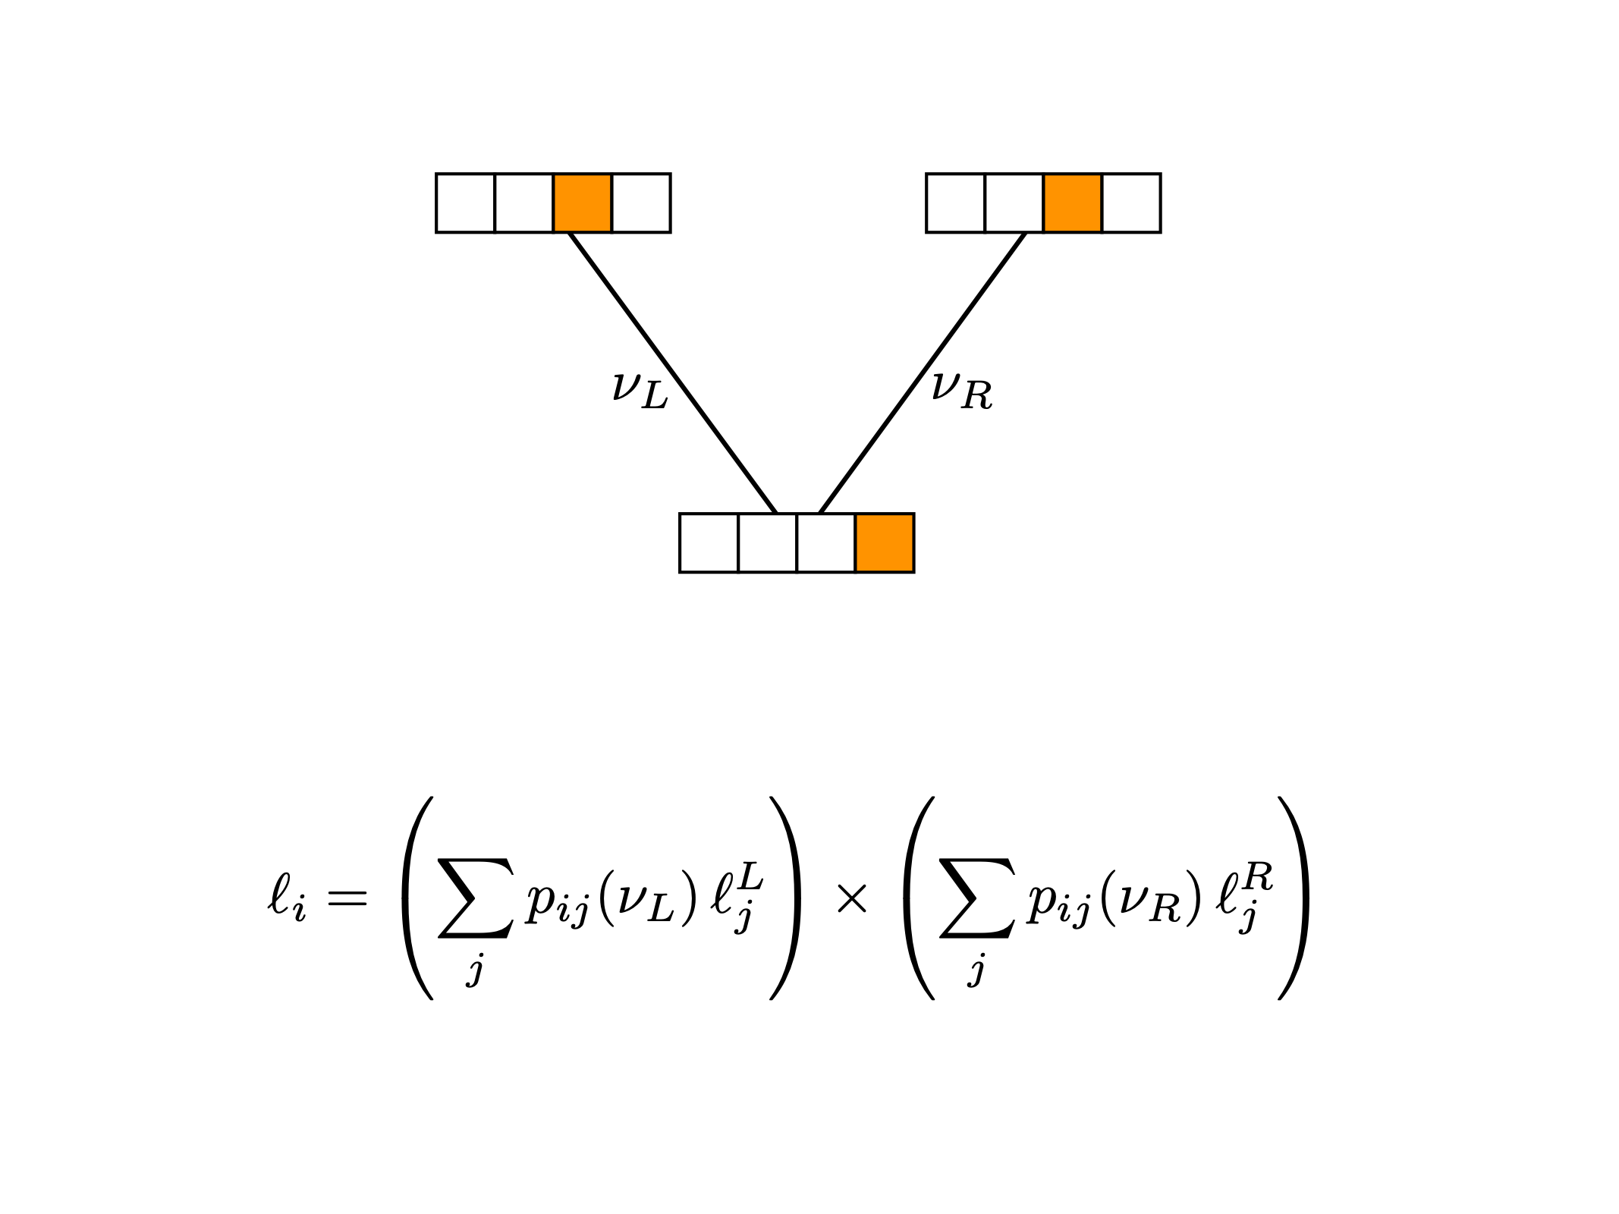
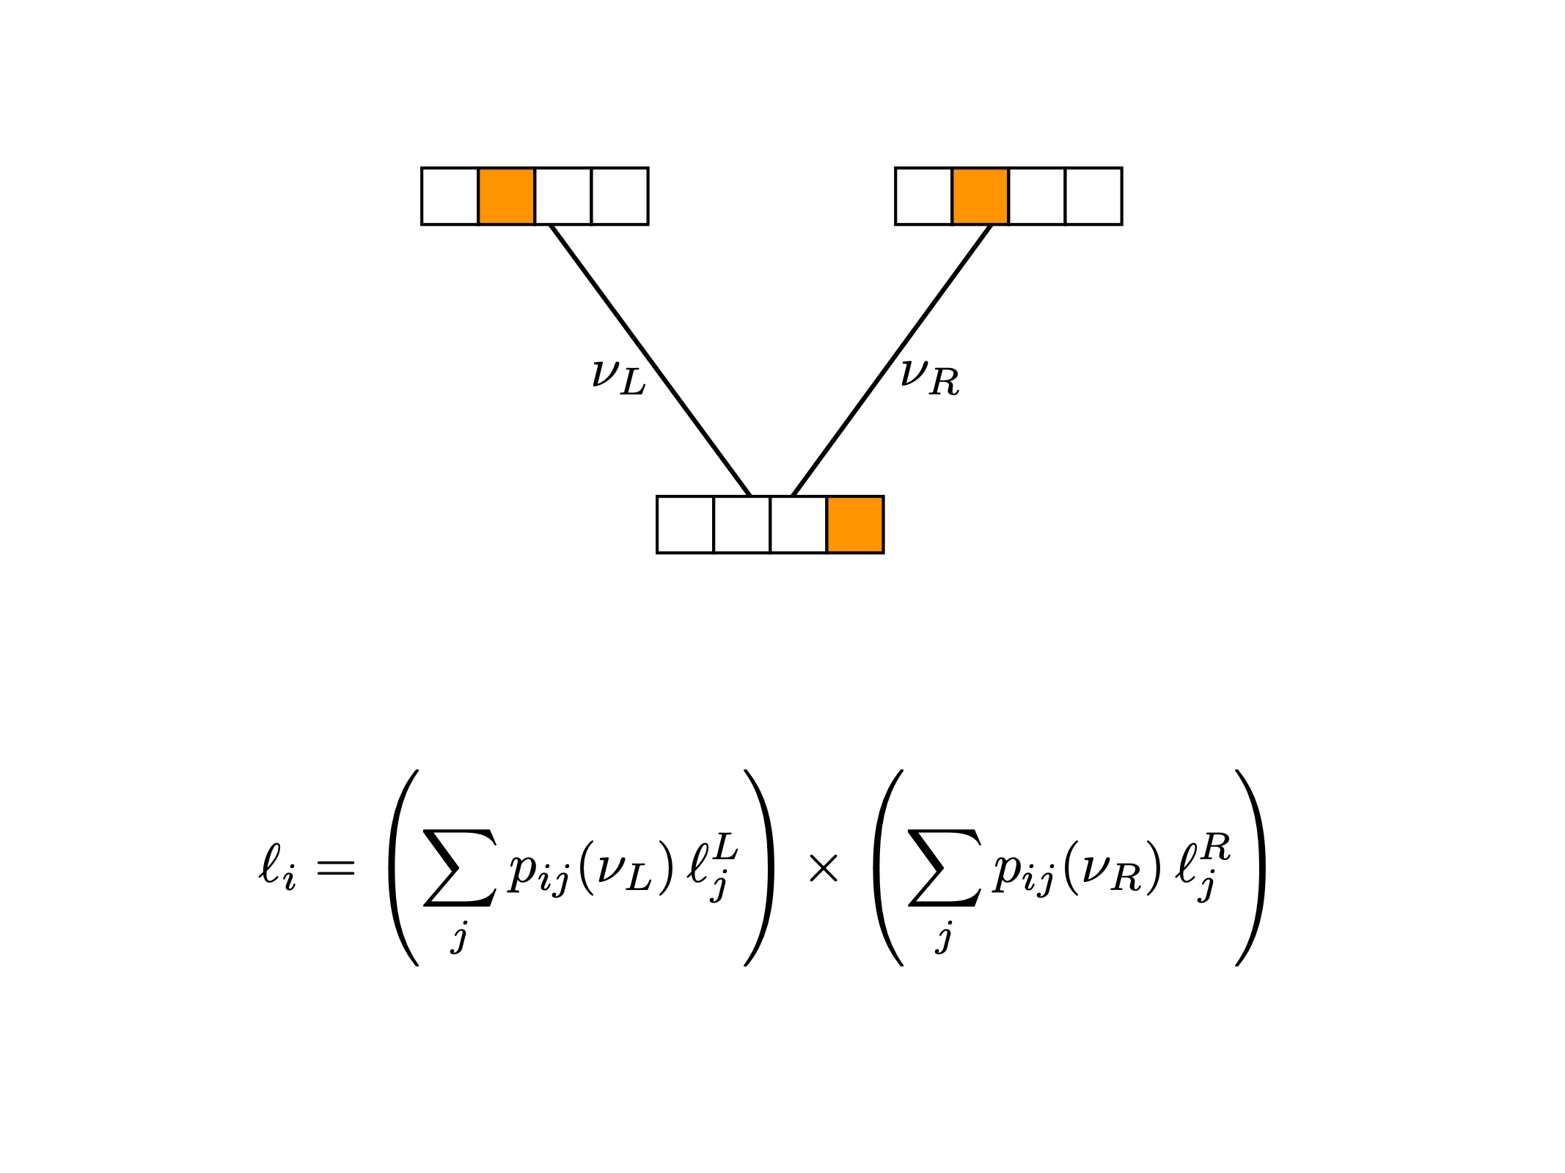
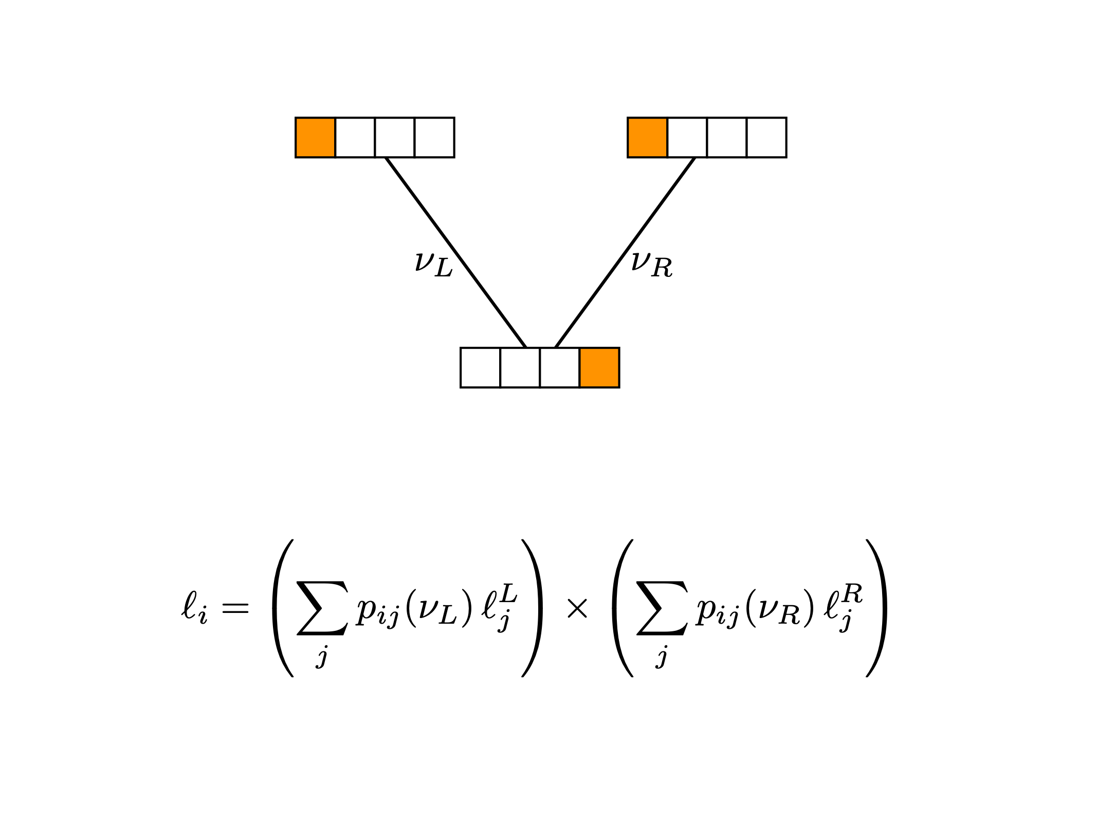
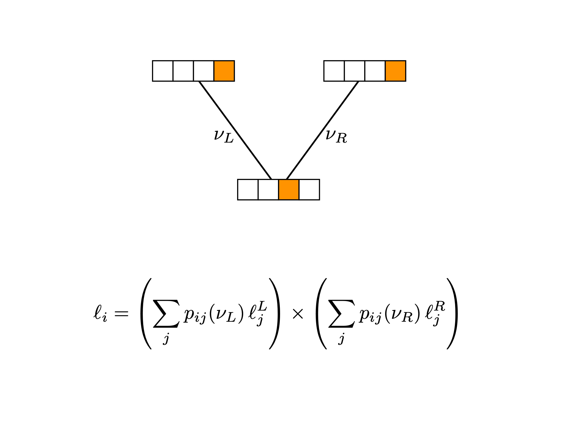
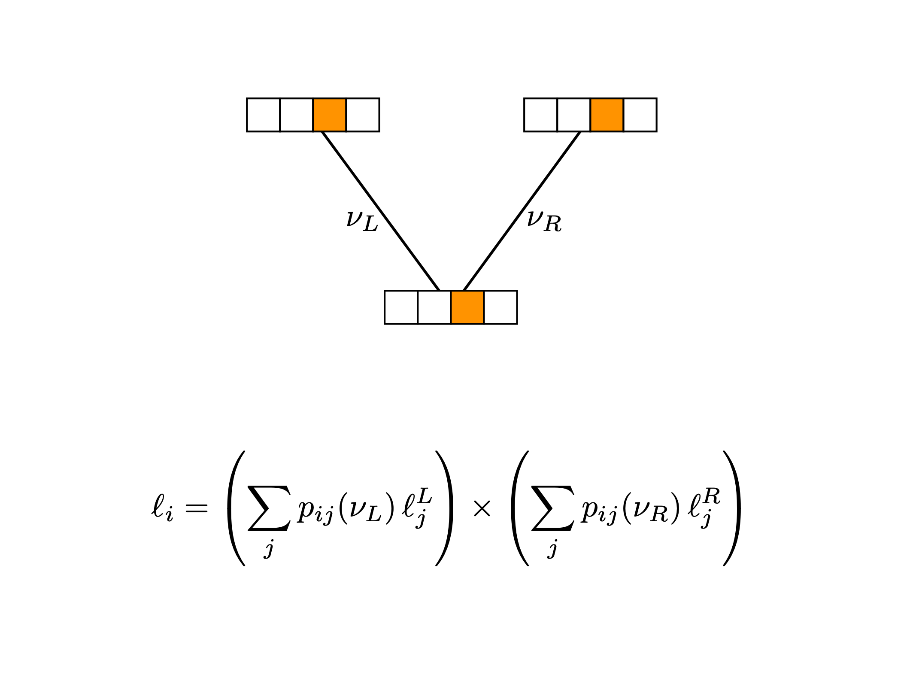
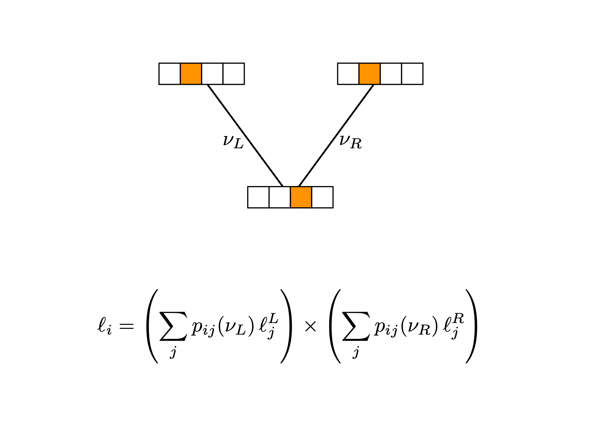
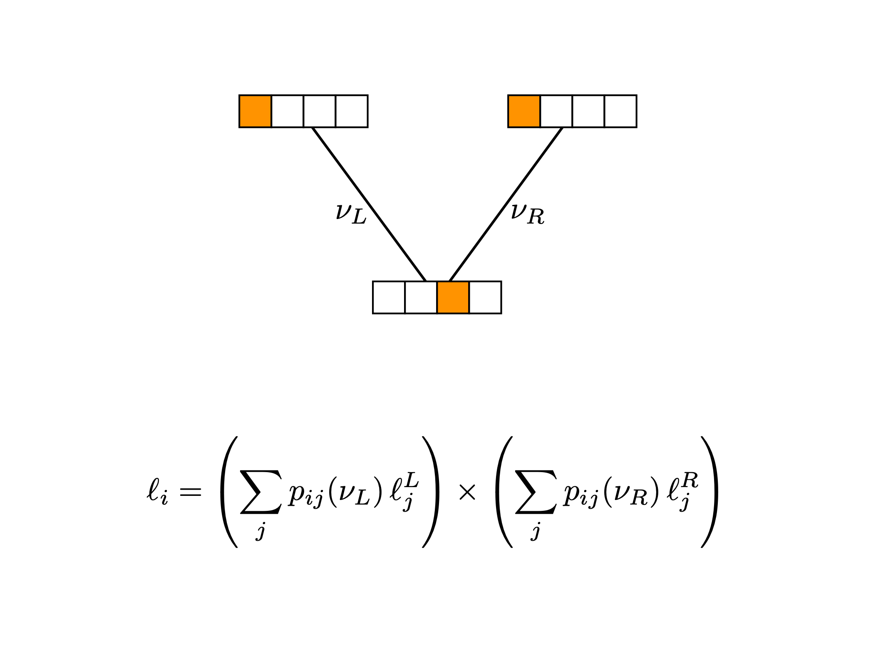
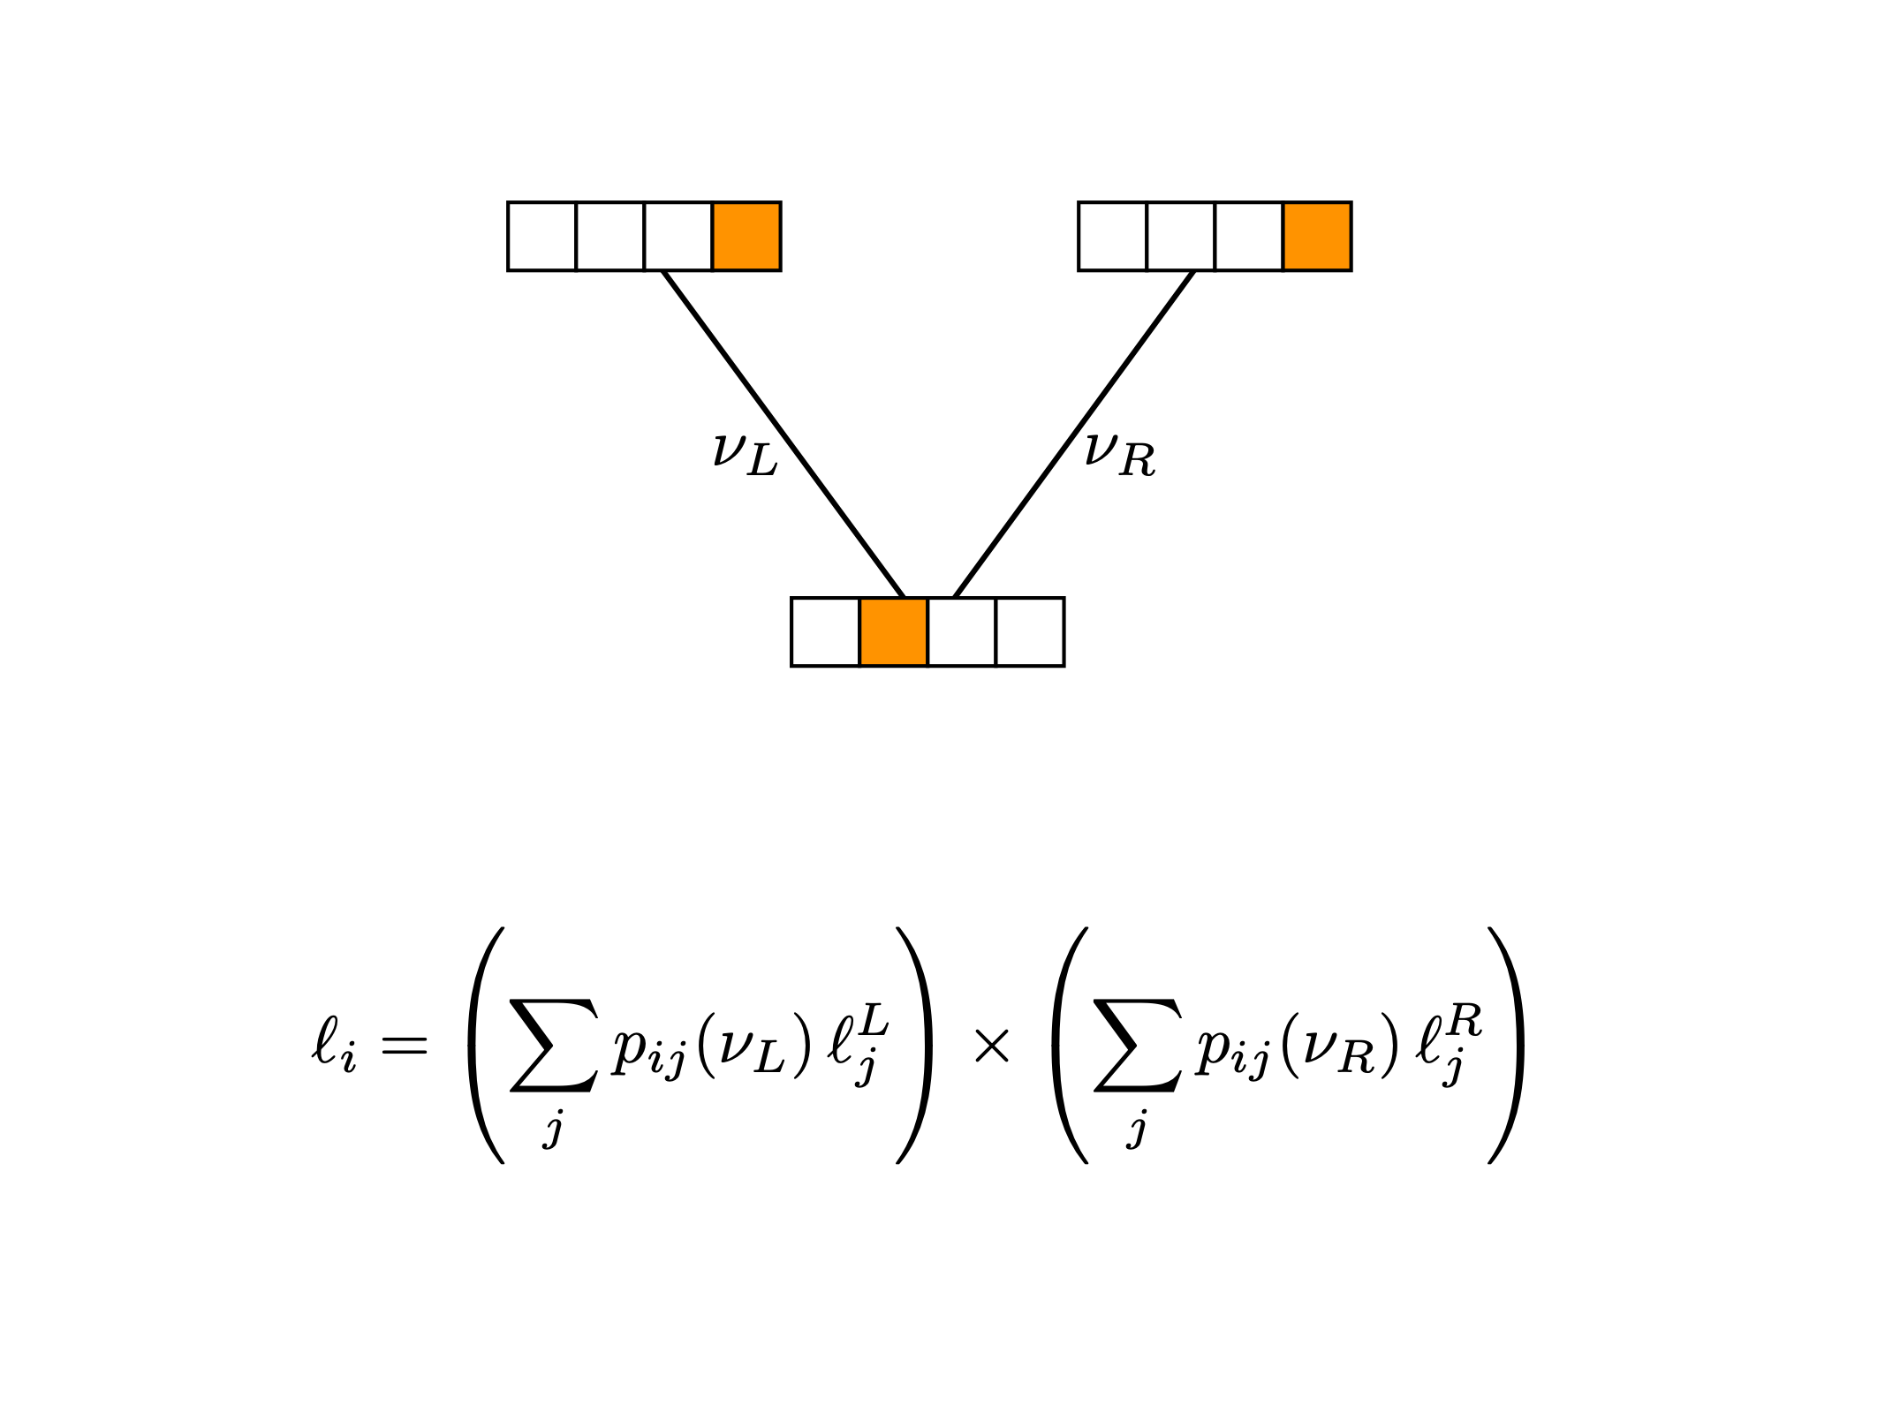
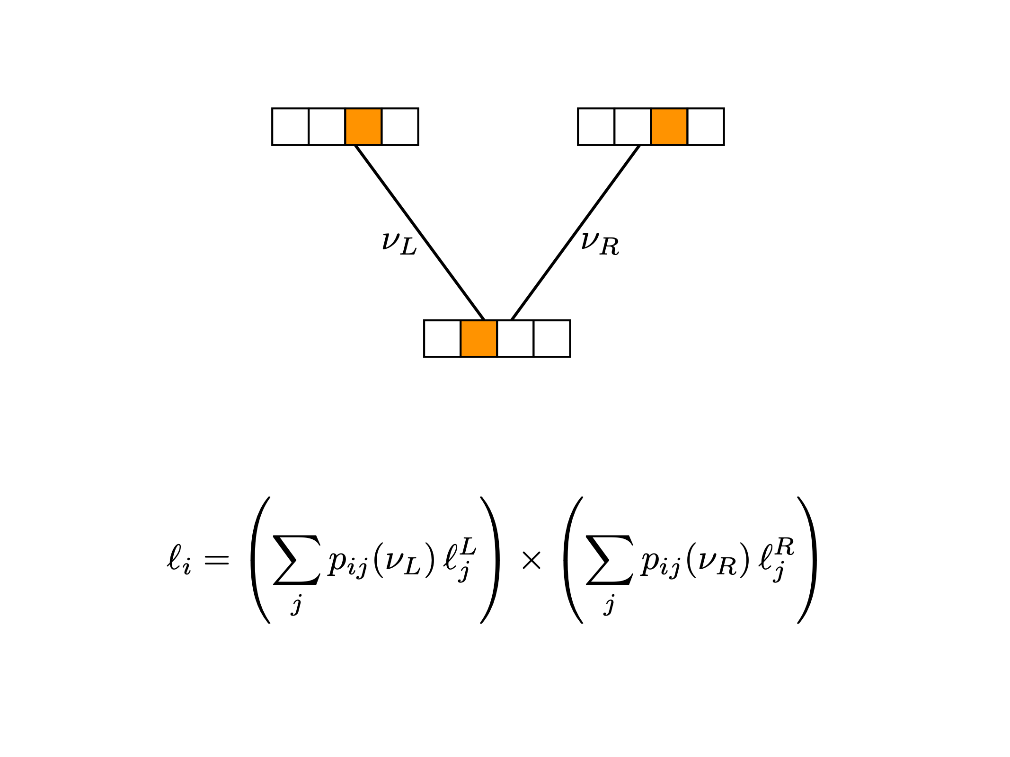
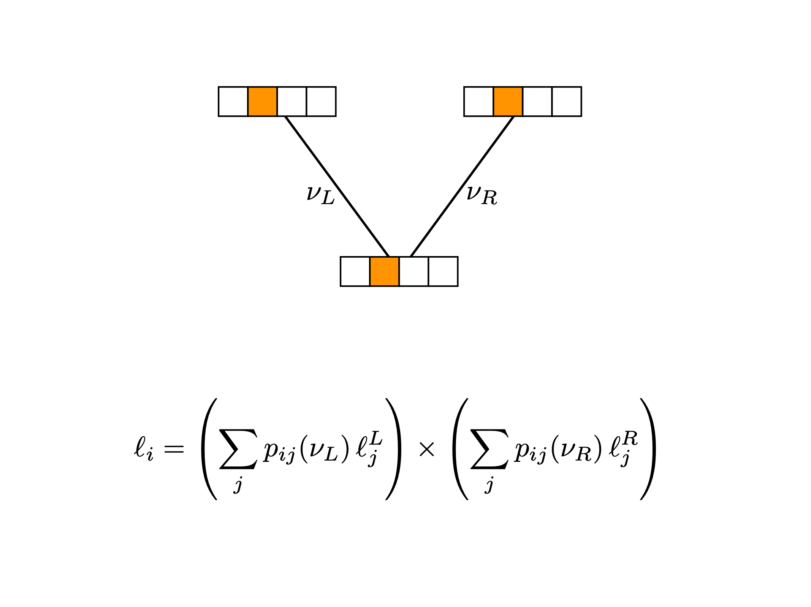
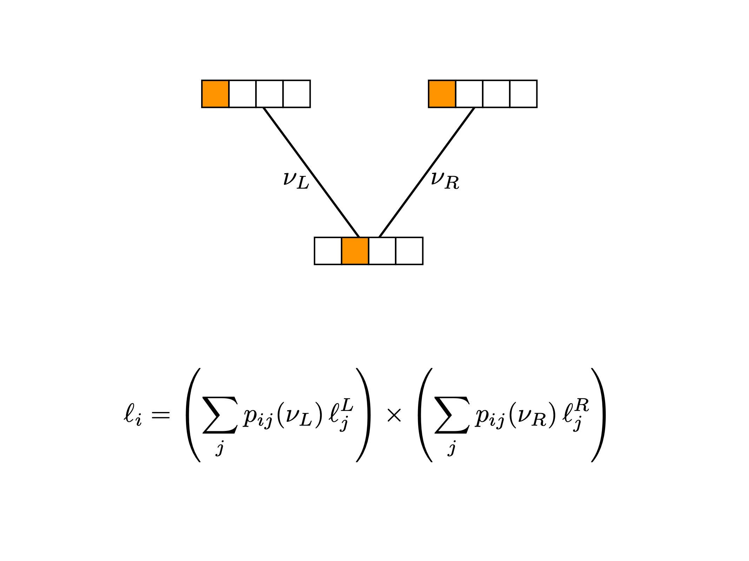
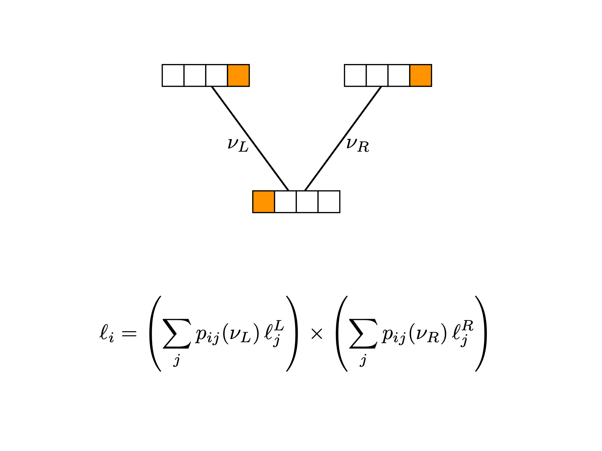
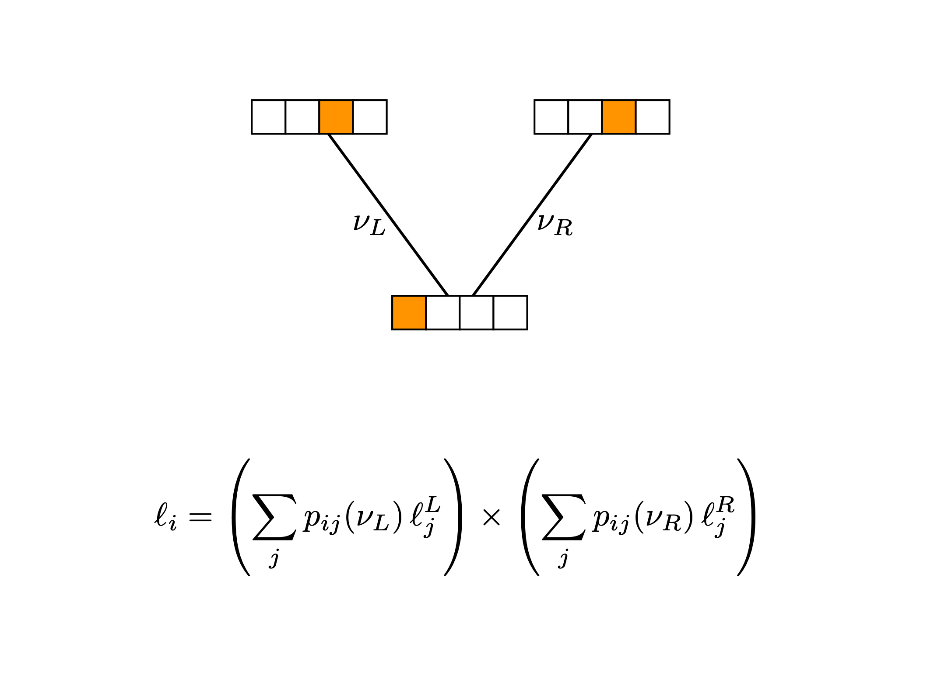
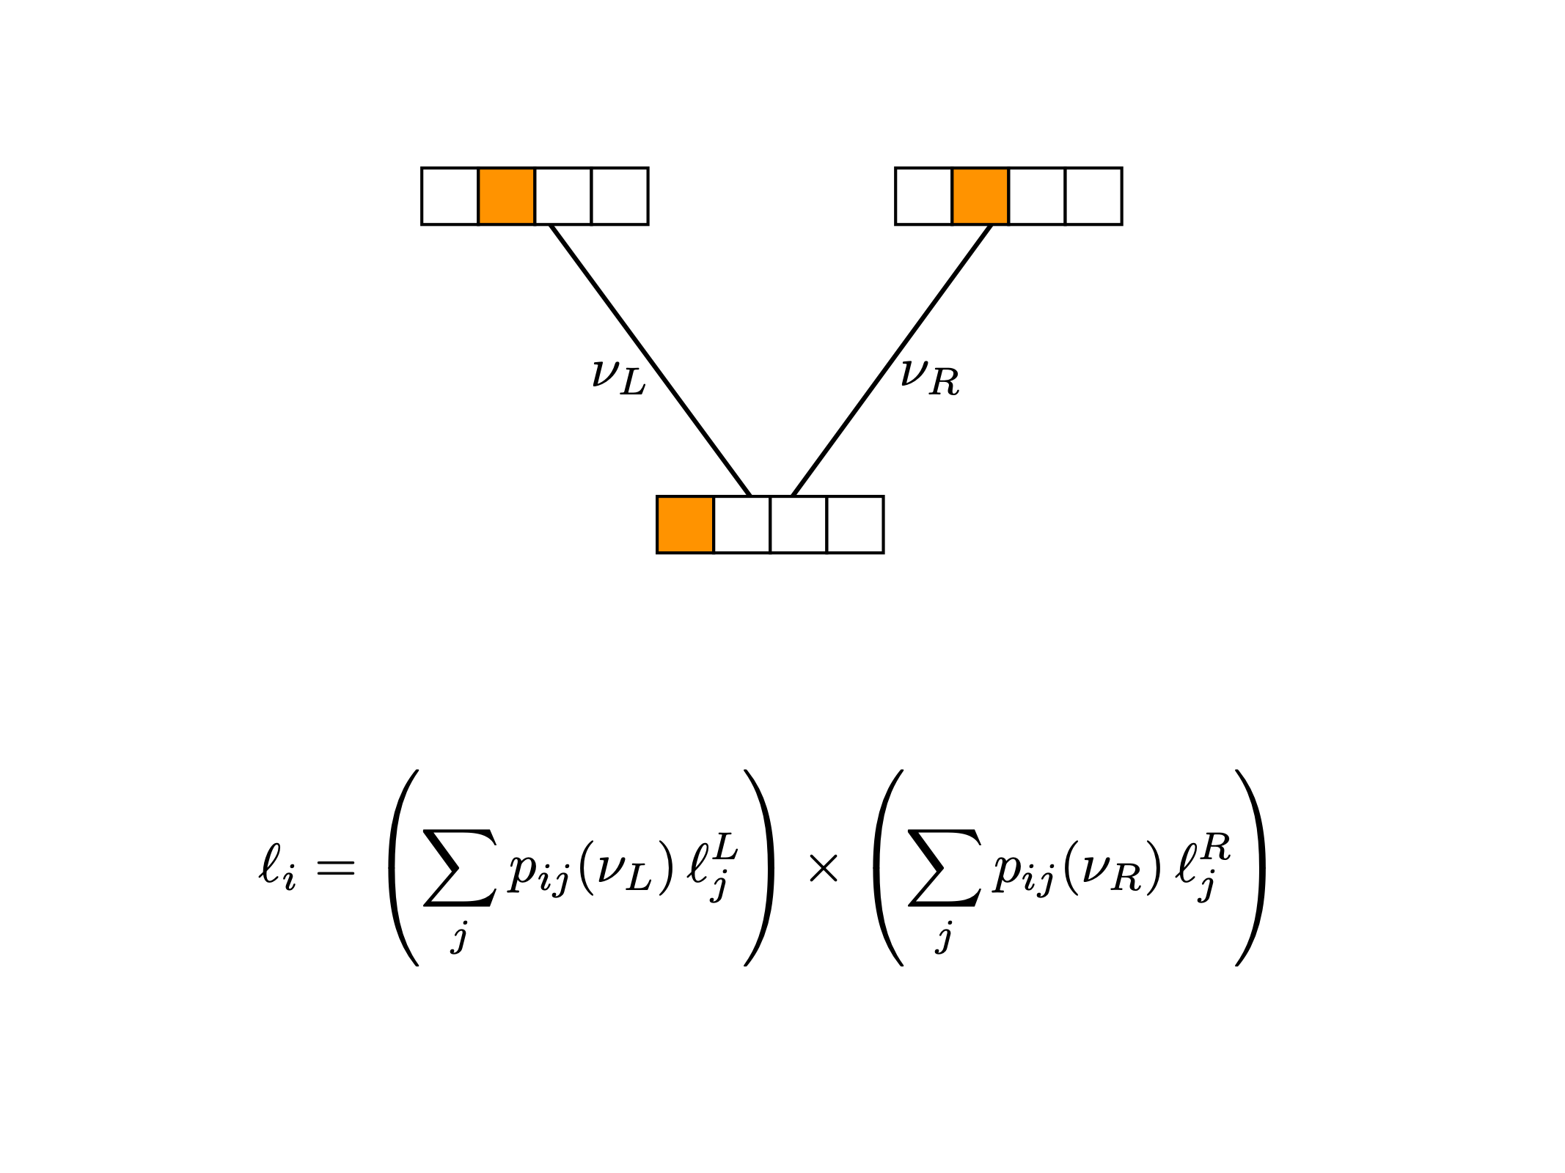
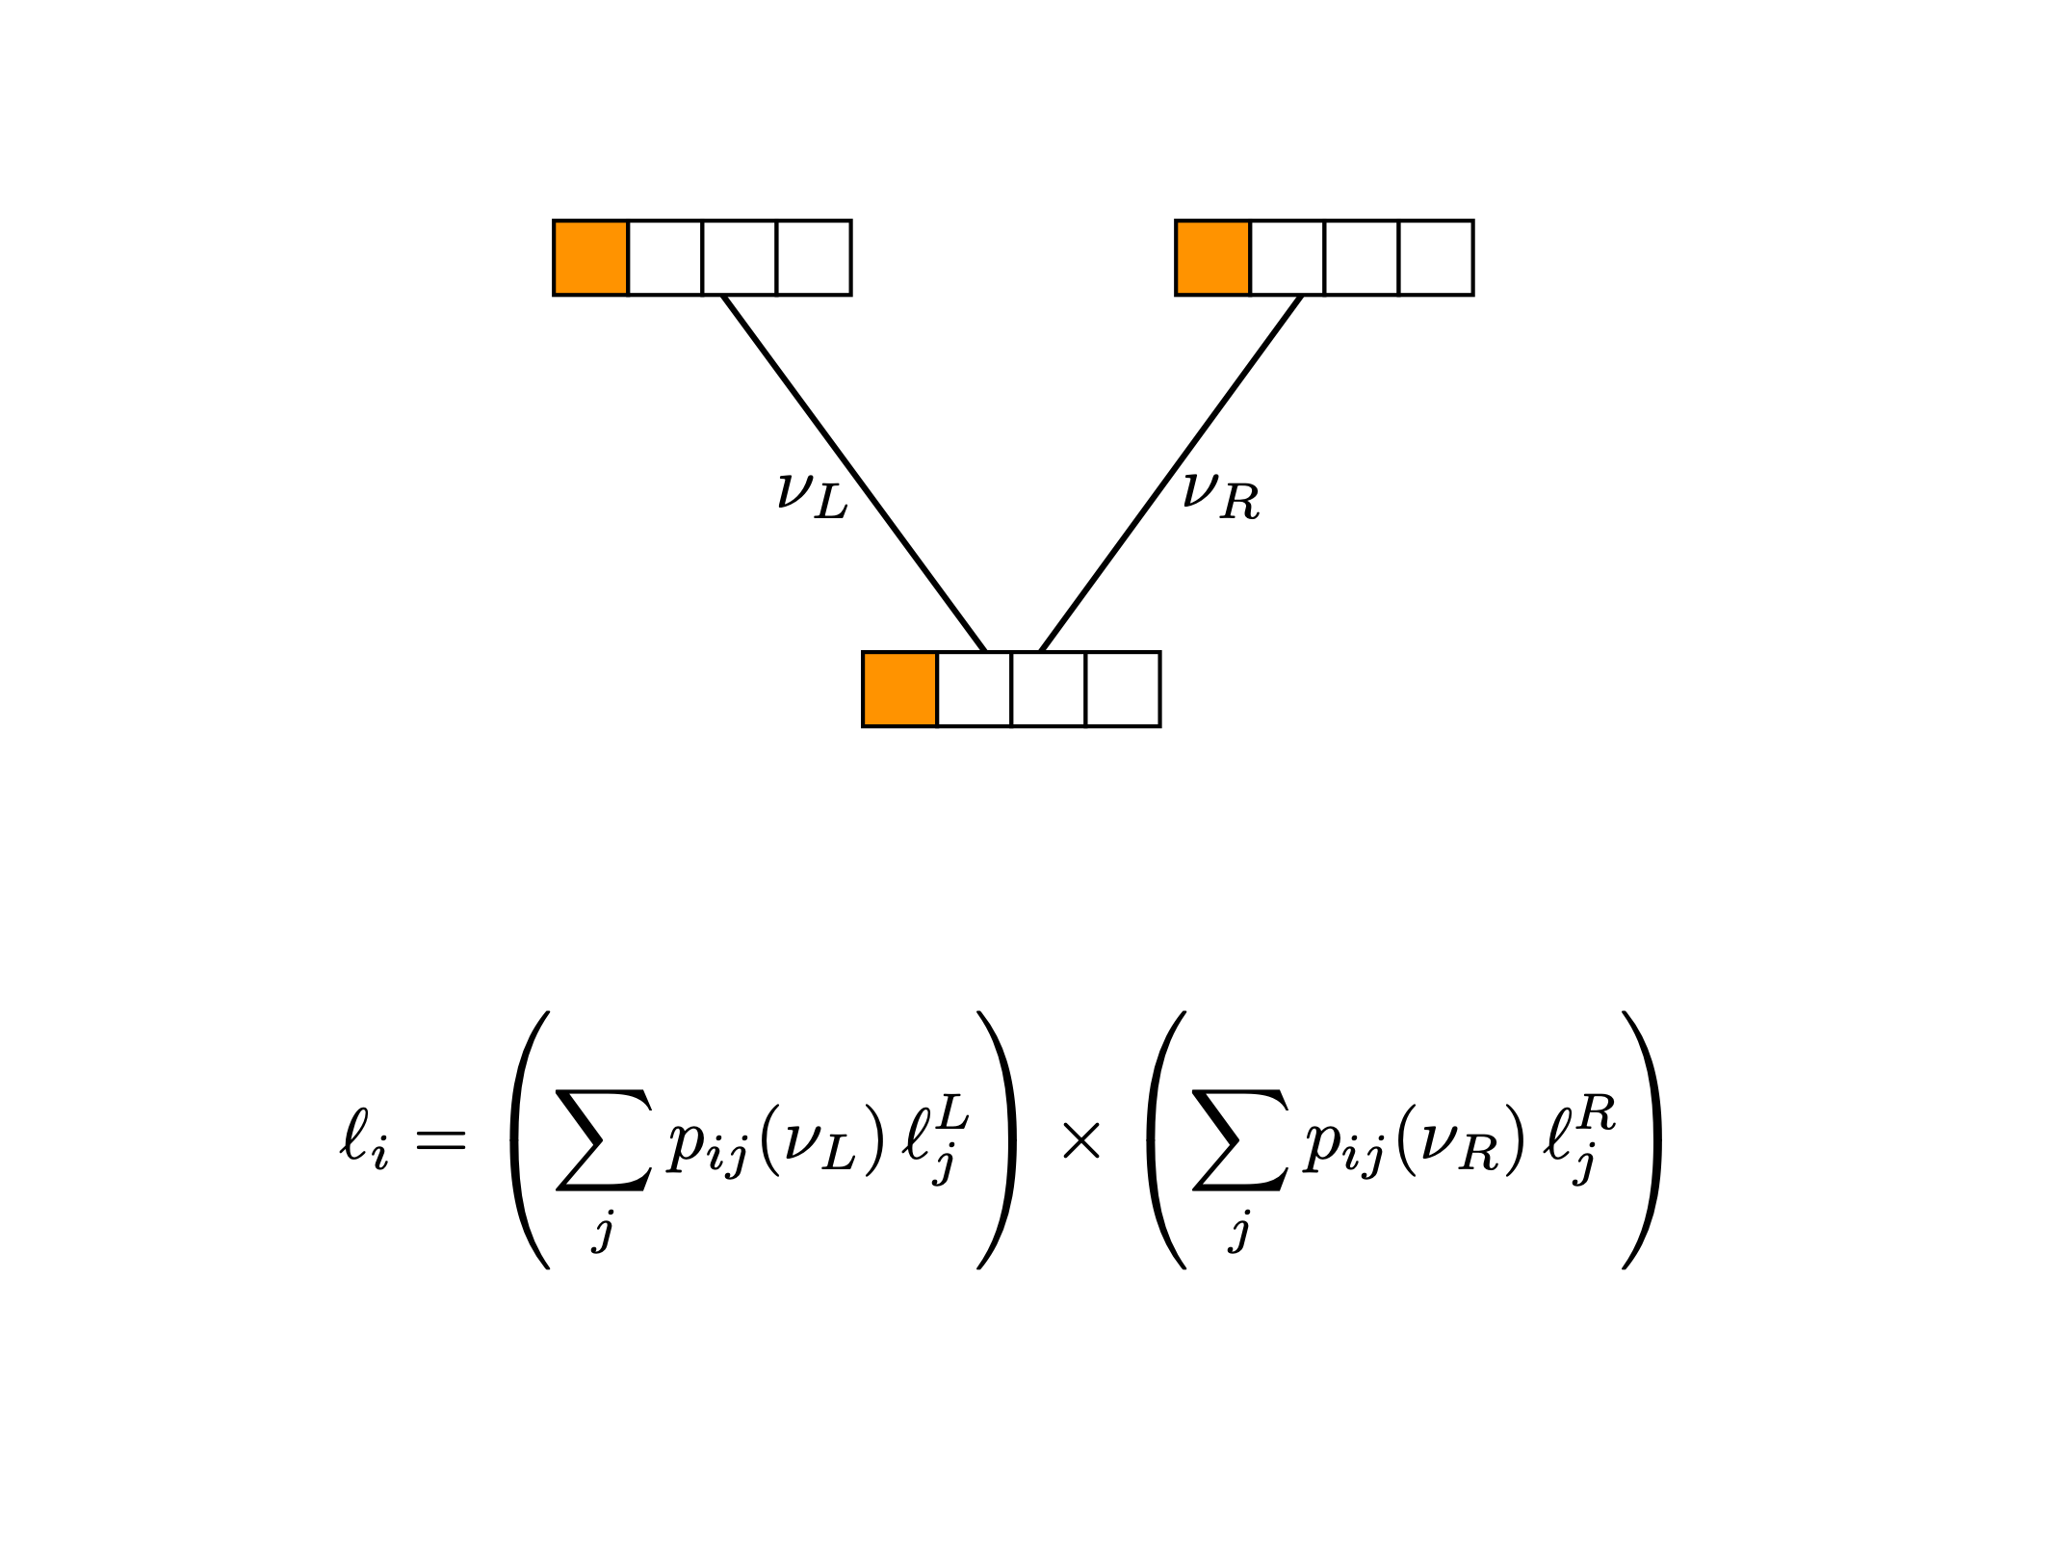
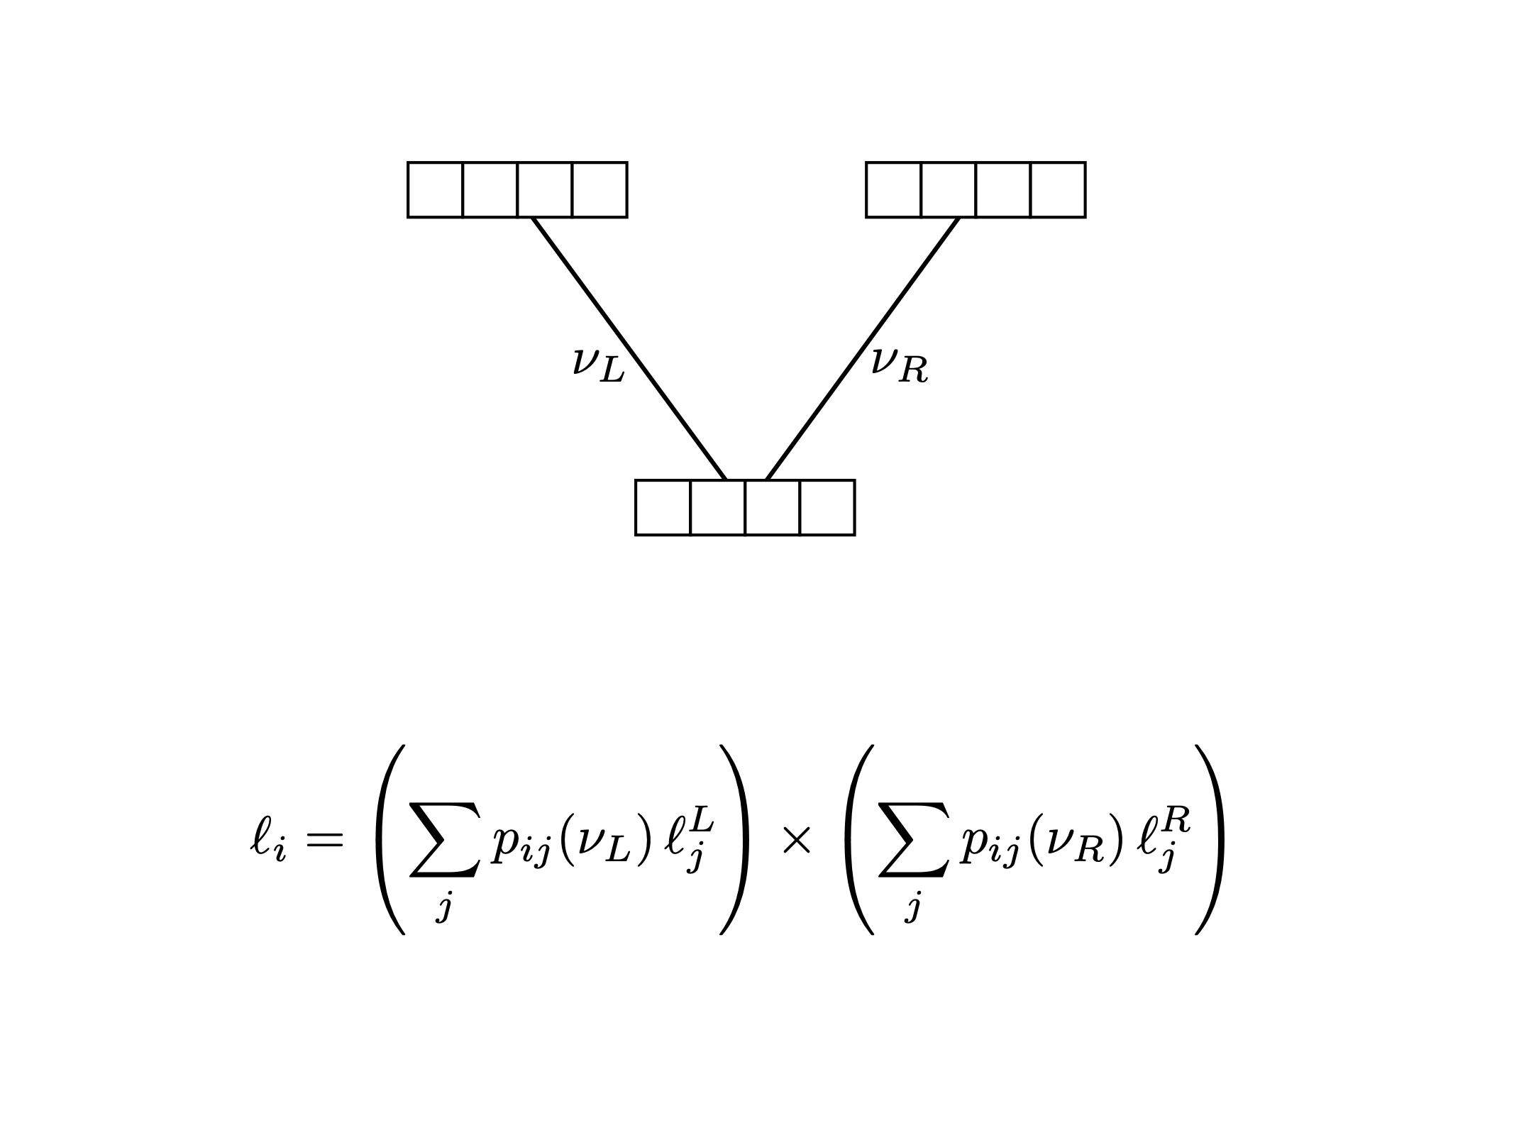
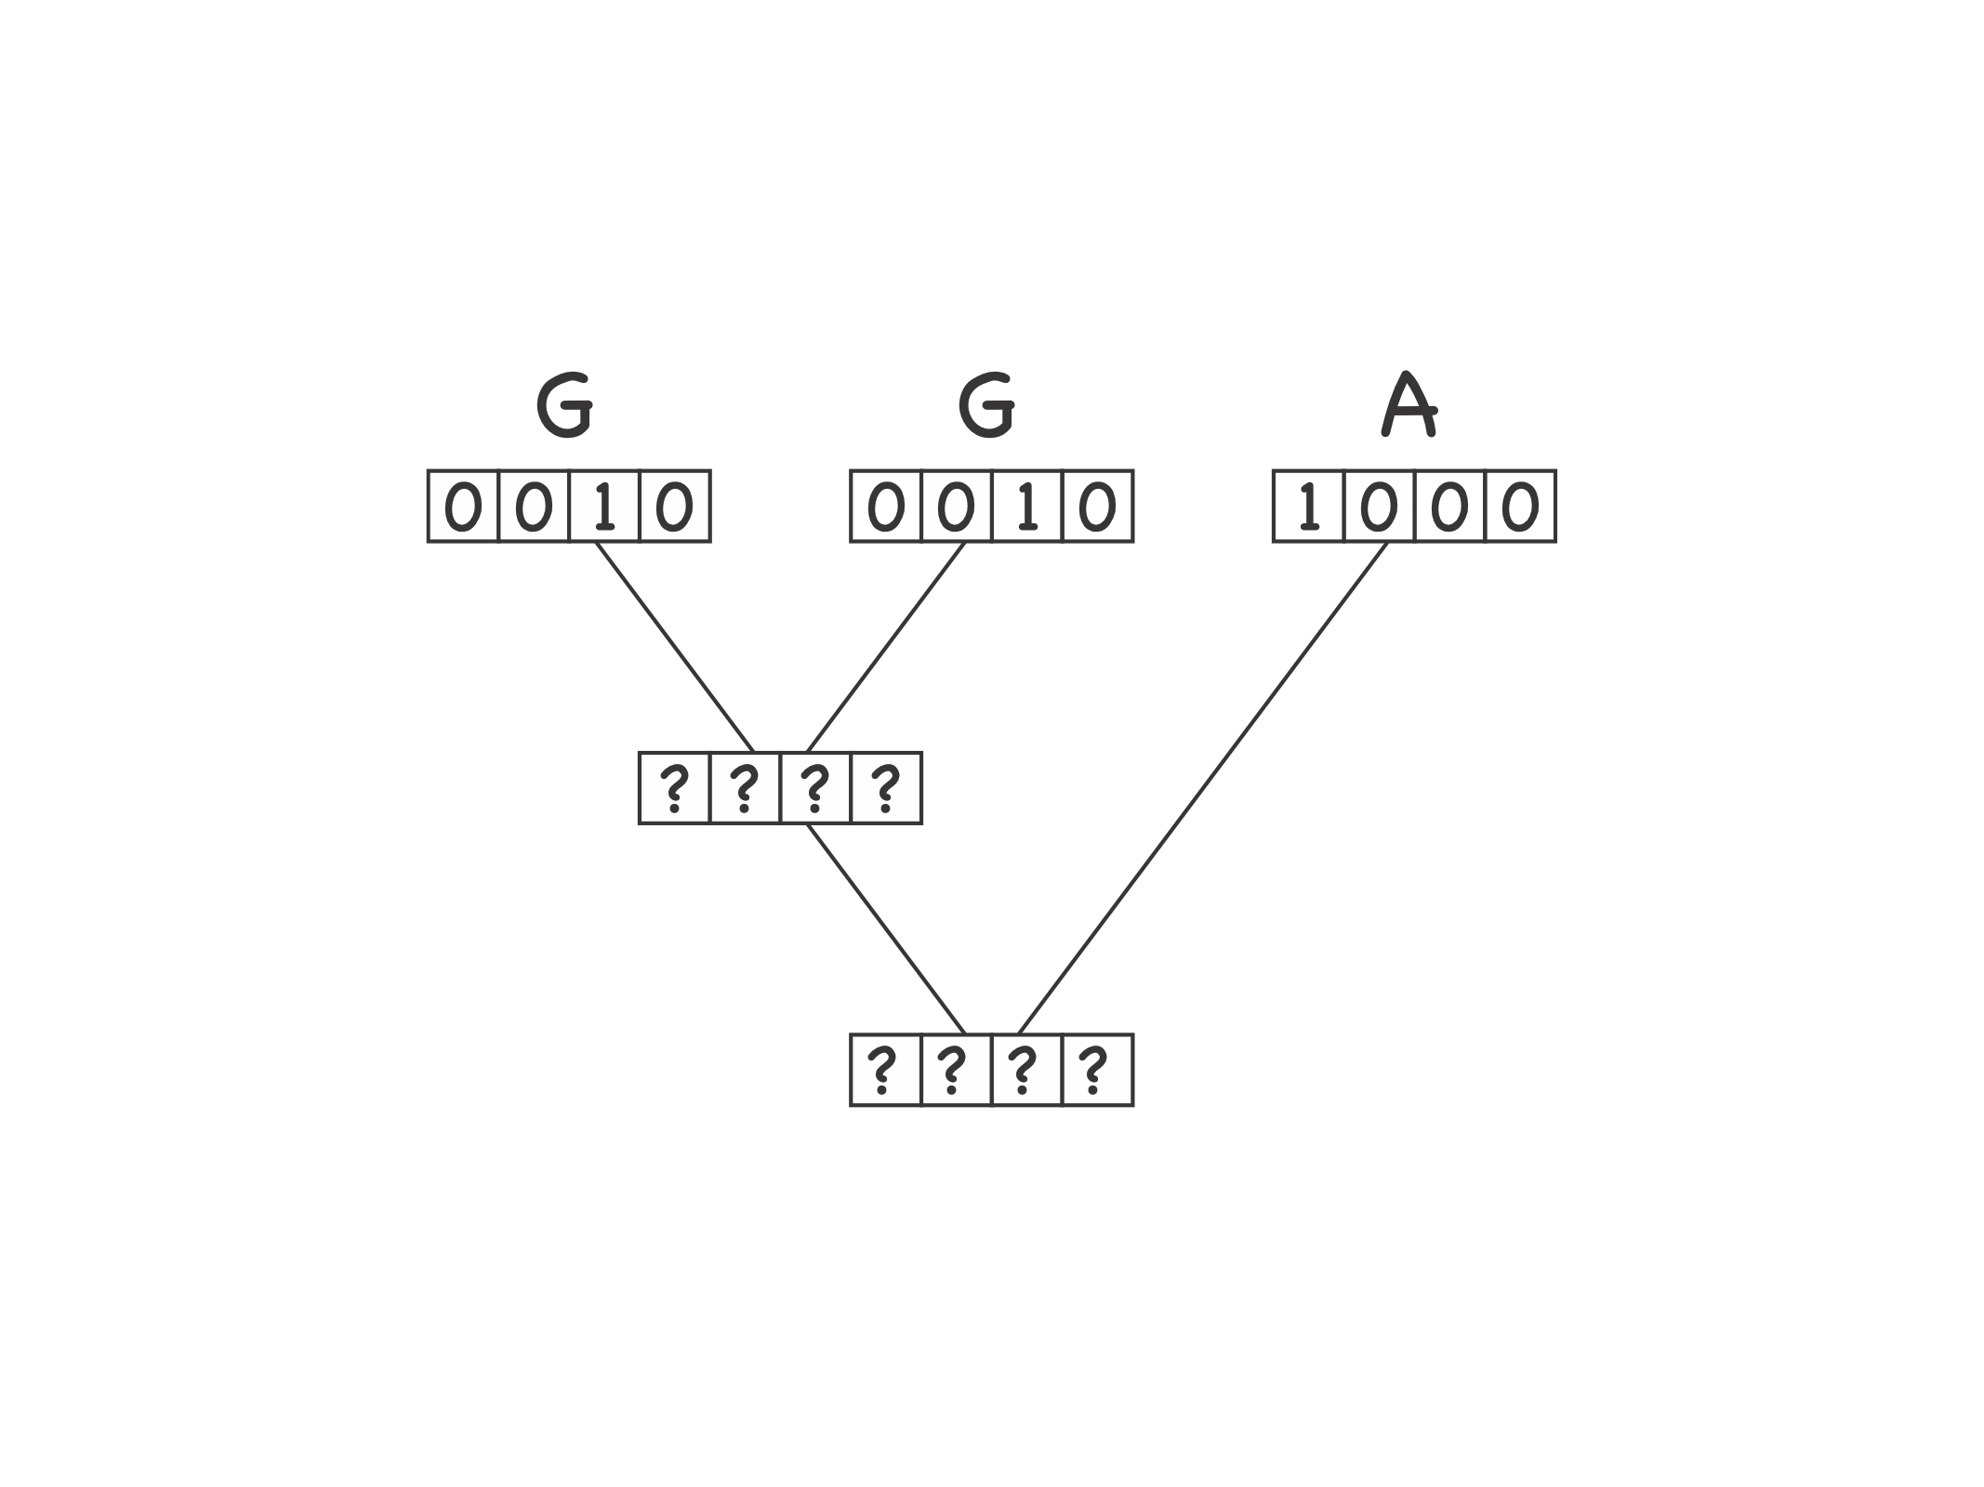
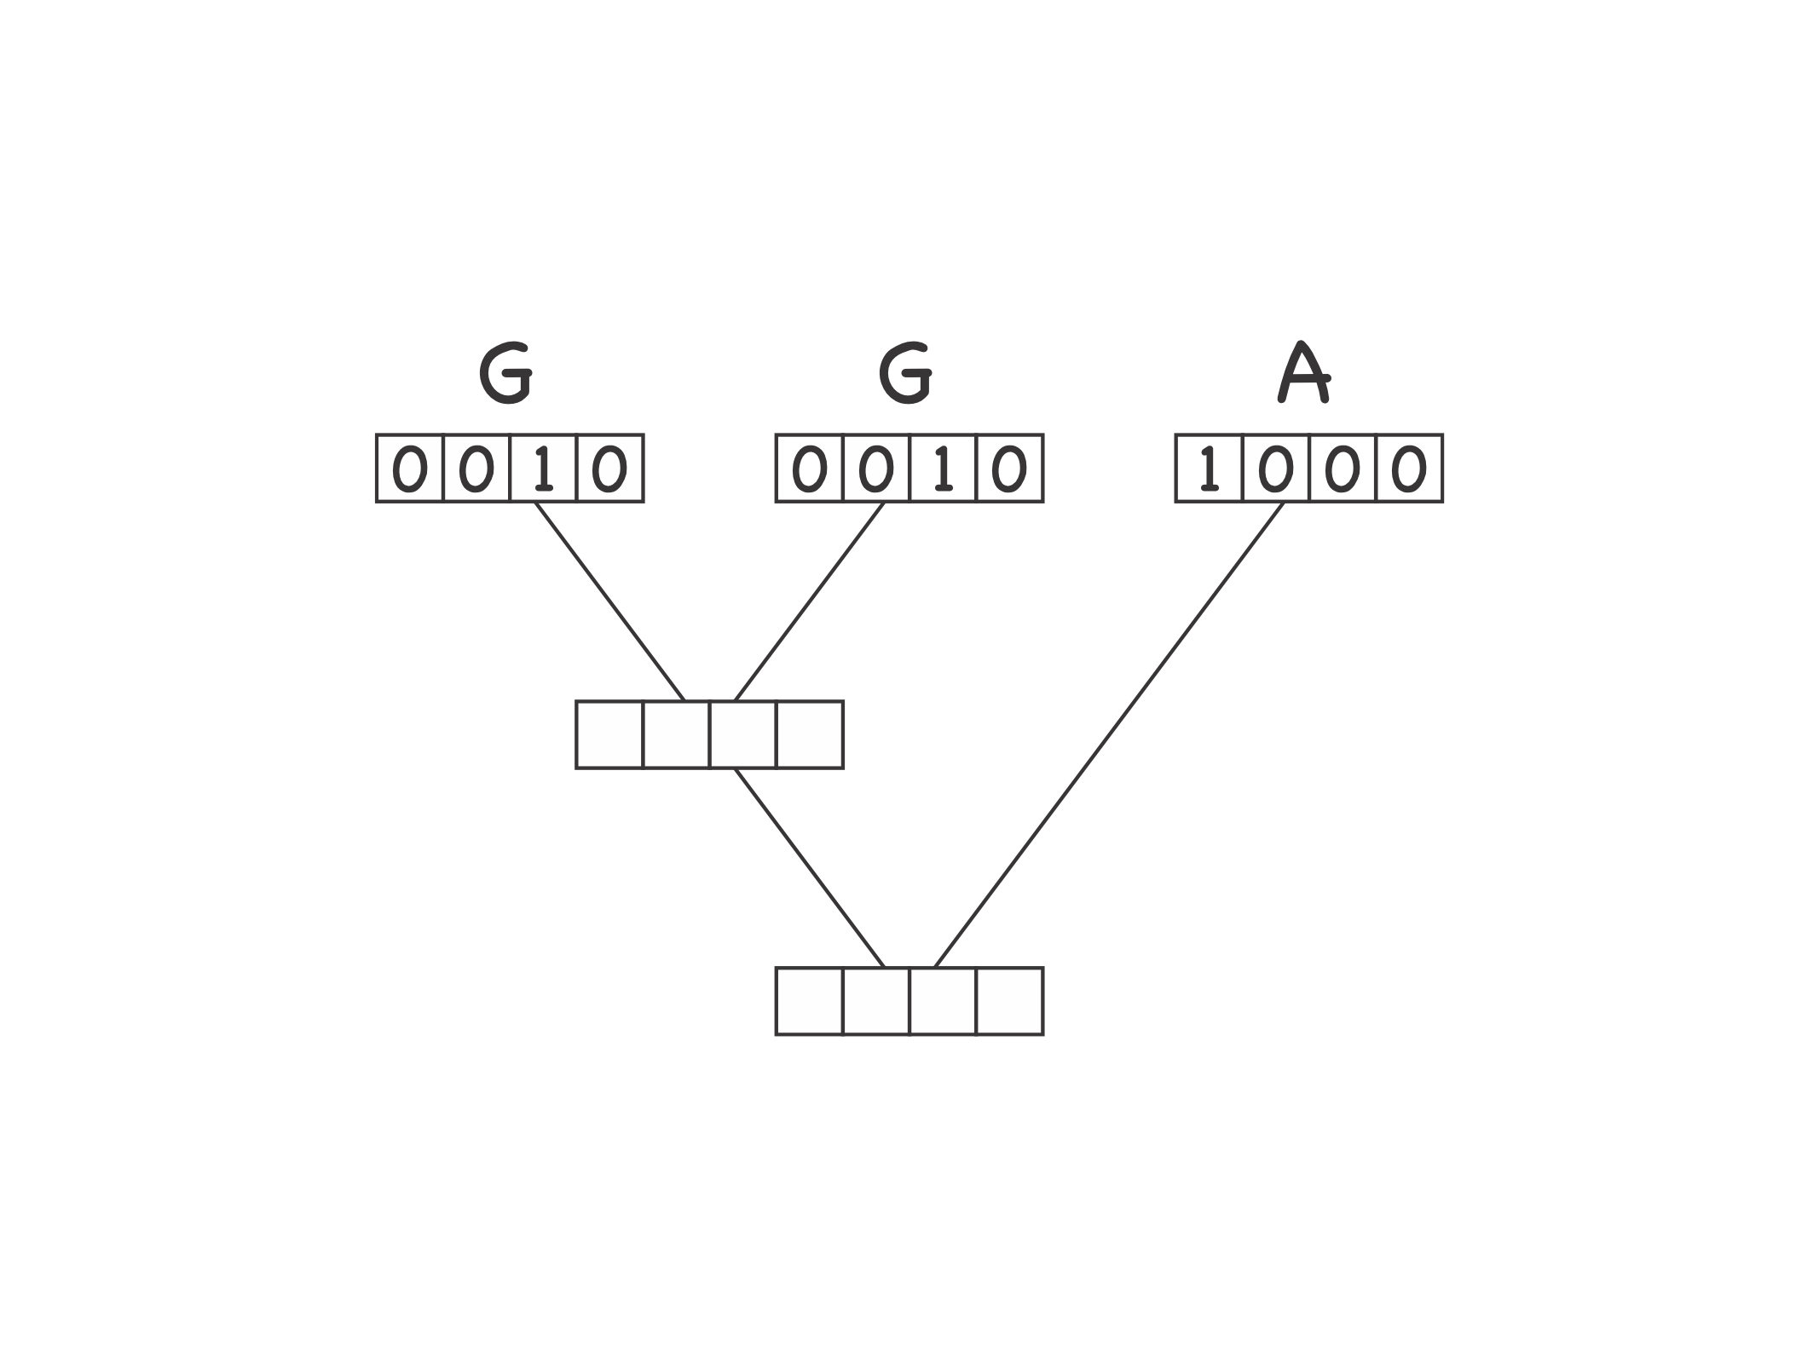
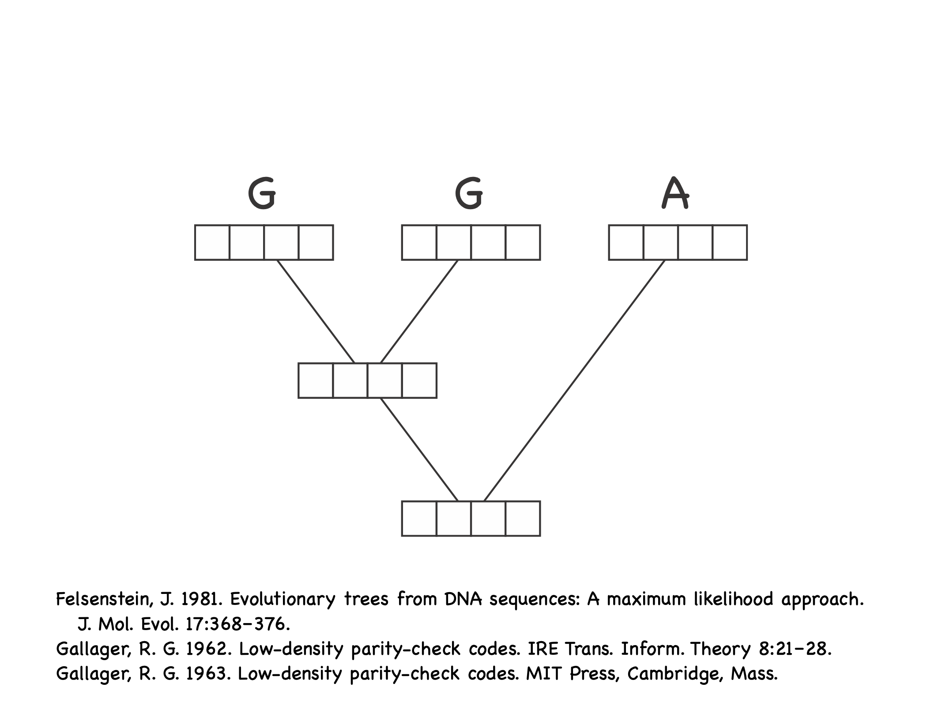
The two great (math) tricks that make it all possible
Problem Two: The number of different possible combinations of states at the internal nodes of a tree of n species is 4^{(n-1).} This is a very big number for any even moderately sized tree! Given that we don’t know what these internal states are, how can we average over all of them?
Trick Two: The pruning algorithm!
Slide courtesy of John Huelsenbeck

Slide 79
The two great (math) tricks that make it all possible
Problem Two: The number of different possible combinations of states at the internal nodes of a tree of n species is 4^{(n-1).} This is a very big number for any even moderately sized tree! Given that we don’t know what these internal states are, how can we average over all of them?
Trick Two: The pruning algorithm!
Can calculate the “conditional likelihoods” of the nodes being in each of the four possible states. These values are the probability of the “upstream” data given that the ancestor has that nucleotide: P(upsteamdata|N)
Slide courtesy of John Huelsenbeck

Slide 80
The two great (math) tricks that make it all possible
Problem Two: The number of different possible combinations of states at the internal nodes of a tree of n species is 4^{(n-1).} This is a very big number for any even moderately sized tree! Given that we don’t know what these internal states are, how can we average over all of them?
Trick Two: The pruning algorithm!
Slide courtesy of John Huelsenbeck

Slide 81
The two great (math) tricks that make it all possible
Problem Two: The number of different possible combinations of states at the internal nodes of a tree of n species is 4^{(n-1).} This is a very big number for any even moderately sized tree! Given that we don’t know what these internal states are, how can we average over all of them?
Trick Two: The pruning algorithm!
Slide courtesy of John Huelsenbeck

Slide 82
The two great (math) tricks that make it all possible
Problem Two: The number of different possible combinations of states at the internal nodes of a tree of n species is 4^{(n-1).} This is a very big number for any even moderately sized tree! Given that we don’t know what these internal states are, how can we average over all of them?
Trick Two: The pruning algorithm!
Slide courtesy of John Huelsenbeck

Slide 83
The two great (math) tricks that make it all possible
Problem Two: The number of different possible combinations of states at the internal nodes of a tree of n species is 4^{(n-1).} This is a very big number for any even moderately sized tree! Given that we don’t know what these internal states are, how can we average over all of them?
Trick Two: The pruning algorithm!
Slide courtesy of John Huelsenbeck

Slide 84
The two great (math) tricks that make it all possible
Problem Two: The number of different possible combinations of states at the internal nodes of a tree of n species is 4^{(n-1).} This is a very big number for any even moderately sized tree! Given that we don’t know what these internal states are, how can we average over all of them?
Trick Two: The pruning algorithm!
Slide courtesy of John Huelsenbeck

Slide 85
The two great (math) tricks that make it all possible
Problem Two: The number of different possible combinations of states at the internal nodes of a tree of n species is 4^{(n-1).} This is a very big number for any even moderately sized tree! Given that we don’t know what these internal states are, how can we average over all of them?
Trick Two: The pruning algorithm!
Slide courtesy of John Huelsenbeck

Slide 86
The two great (math) tricks that make it all possible
Problem Two: The number of different possible combinations of states at the internal nodes of a tree of n species is 4^{(n-1).} This is a very big number for any even moderately sized tree! Given that we don’t know what these internal states are, how can we average over all of them?
Trick Two: The pruning algorithm!
Slide courtesy of John Huelsenbeck

Slide 87
The two great (math) tricks that make it all possible
Problem Two: The number of different possible combinations of states at the internal nodes of a tree of n species is 4^{(n-1).} This is a very big number for any even moderately sized tree! Given that we don’t know what these internal states are, how can we average over all of them?
Trick Two: The pruning algorithm!
Slide courtesy of John Huelsenbeck

Slide 88
The two great (math) tricks that make it all possible
Problem Two: The number of different possible combinations of states at the internal nodes of a tree of n species is 4^{(n-1).} This is a very big number for any even moderately sized tree! Given that we don’t know what these internal states are, how can we average over all of them?
Trick Two: The pruning algorithm!
Slide courtesy of John Huelsenbeck

Slide 89
The two great (math) tricks that make it all possible
Problem Two: The number of different possible combinations of states at the internal nodes of a tree of n species is 4^{(n-1).} This is a very big number for any even moderately sized tree! Given that we don’t know what these internal states are, how can we average over all of them?
Trick Two: The pruning algorithm!
Slide courtesy of John Huelsenbeck

Slide 90
The two great (math) tricks that make it all possible
Problem Two: The number of different possible combinations of states at the internal nodes of a tree of n species is 4^{(n-1).} This is a very big number for any even moderately sized tree! Given that we don’t know what these internal states are, how can we average over all of them?
Trick Two: The pruning algorithm!
Slide courtesy of John Huelsenbeck

Slide 91
The two great (math) tricks that make it all possible
Problem Two: The number of different possible combinations of states at the internal nodes of a tree of n species is 4^{(n-1).} This is a very big number for any even moderately sized tree! Given that we don’t know what these internal states are, how can we average over all of them?
Trick Two: The pruning algorithm!
Slide courtesy of John Huelsenbeck

Slide 92
The two great (math) tricks that make it all possible
Problem Two: The number of different possible combinations of states at the internal nodes of a tree of n species is 4^{(n-1).} This is a very big number for any even moderately sized tree! Given that we don’t know what these internal states are, how can we average over all of them?
Trick Two: The pruning algorithm!
Slide courtesy of John Huelsenbeck

Slide 93
The two great (math) tricks that make it all possible
Problem Two: The number of different possible combinations of states at the internal nodes of a tree of n species is 4^{(n-1).} This is a very big number for any even moderately sized tree! Given that we don’t know what these internal states are, how can we average over all of them?
Trick Two: The pruning algorithm!
Slide courtesy of John Huelsenbeck

Slide 94
The two great (math) tricks that make it all possible
Problem Two: The number of different possible combinations of states at the internal nodes of a tree of n species is 4^{(n-1).} This is a very big number for any even moderately sized tree! Given that we don’t know what these internal states are, how can we average over all of them?
Trick Two: The pruning algorithm!
Slide courtesy of John Huelsenbeck

Slide 95
The two great (math) tricks that make it all possible
Problem Two: The number of different possible combinations of states at the internal nodes of a tree of n species is 4^{(n-1).} This is a very big number for any even moderately sized tree! Given that we don’t know what these internal states are, how can we average over all of them?
Trick Two: The pruning algorithm!
Slide courtesy of John Huelsenbeck

Slide 96
The two great (math) tricks that make it all possible
Problem Two: The number of different possible combinations of states at the internal nodes of a tree of n species is 4^{(n-1).} This is a very big number for any even moderately sized tree! Given that we don’t know what these internal states are, how can we average over all of them?
Trick Two: The pruning algorithm!
Slide courtesy of John Huelsenbeck

Slide 97
The two great (math) tricks that make it all possible
Problem Two: The number of different possible combinations of states at the internal nodes of a tree of n species is 4^{(n-1).} This is a very big number for any even moderately sized tree! Given that we don’t know what these internal states are, how can we average over all of them?
Trick Two: The pruning algorithm!
Slide courtesy of John Huelsenbeck

Slide 98
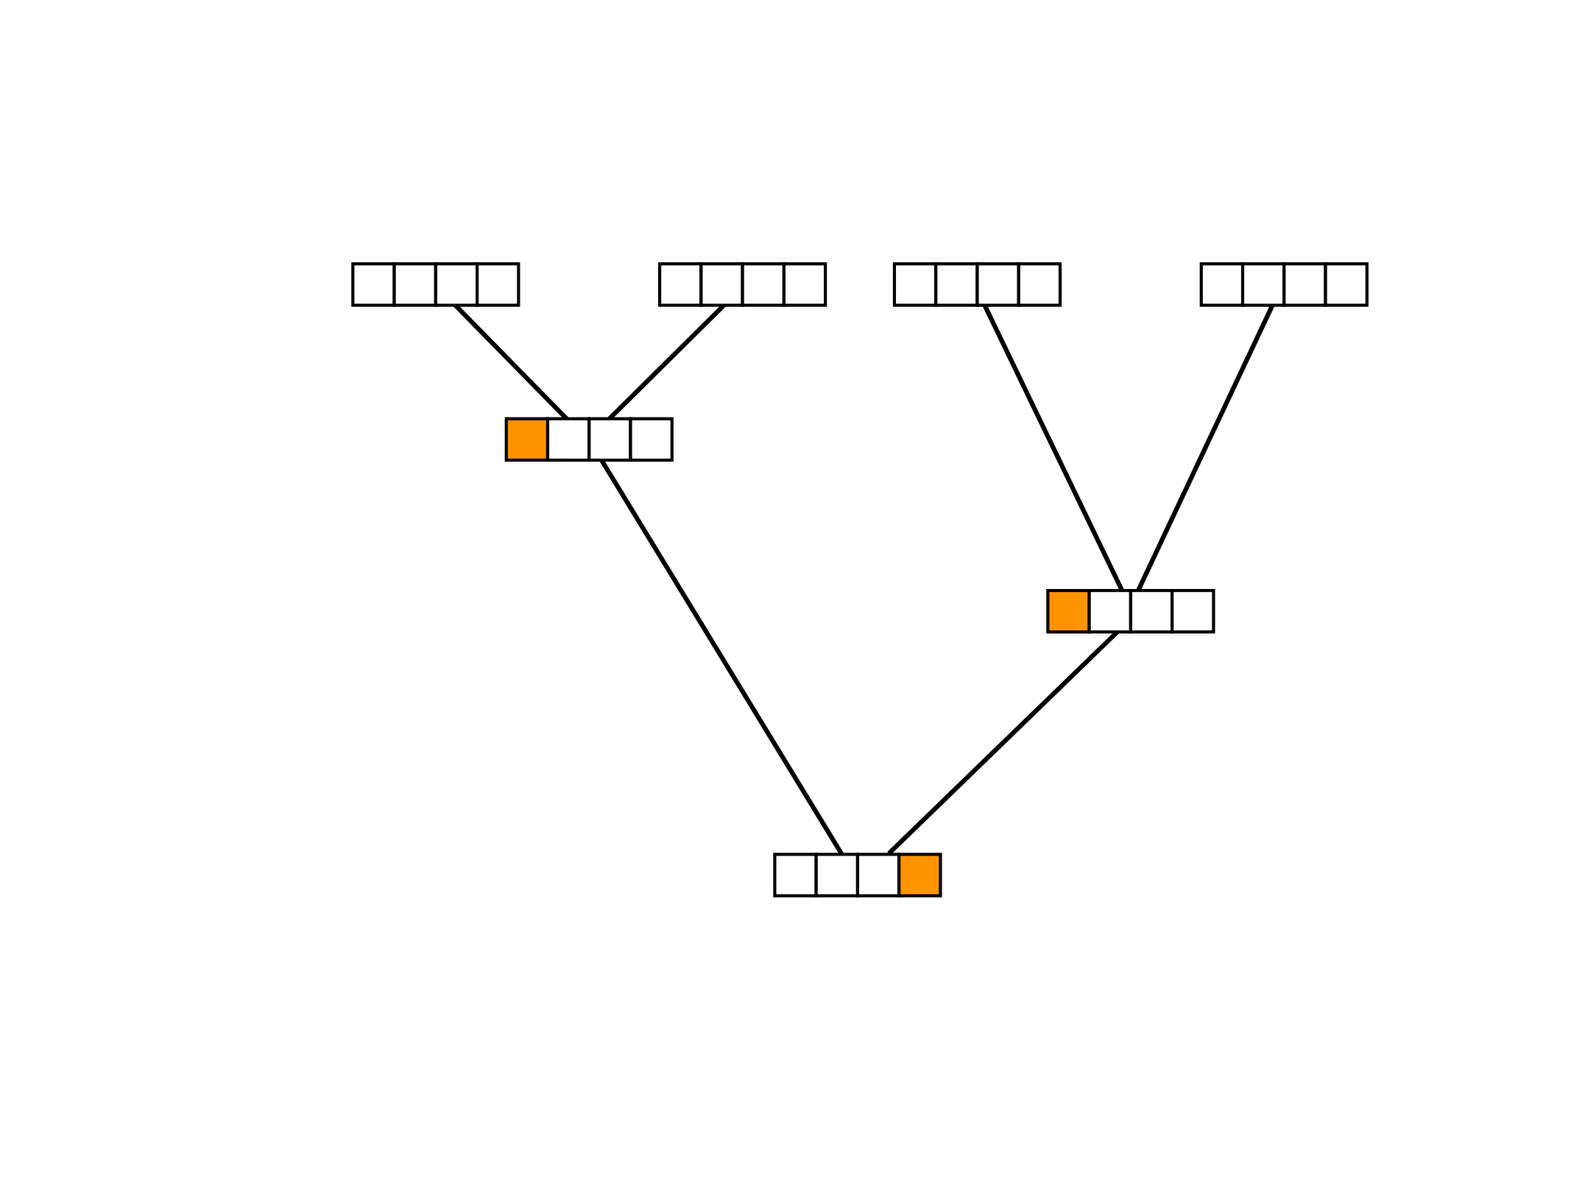
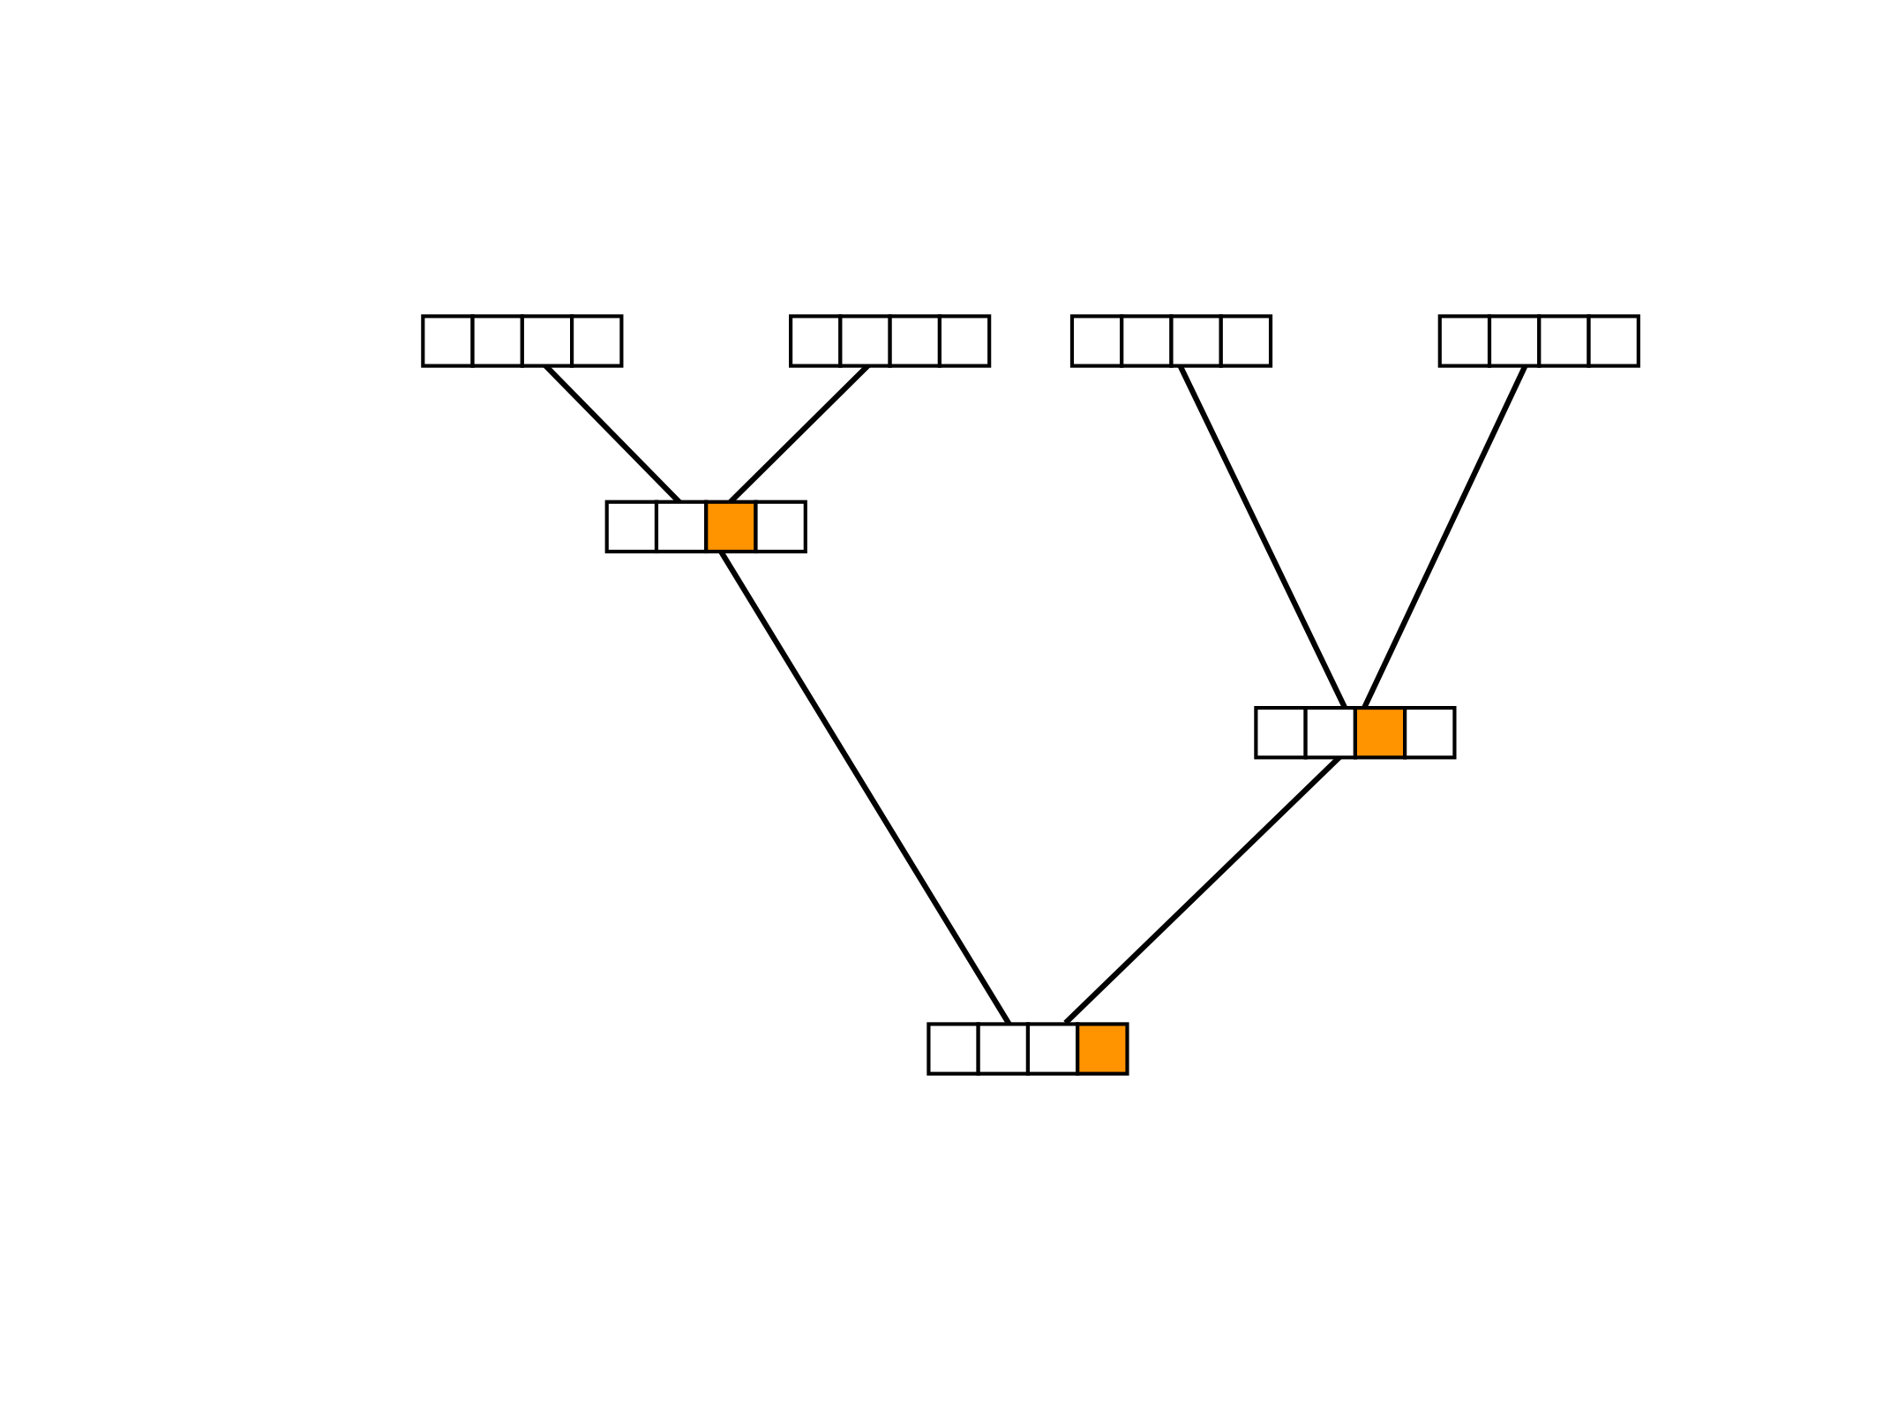
The two great (math) tricks that make it all possible
Problem Two: The number of different possible combinations of states at the internal nodes of a tree of n species is 4^{(n-1).} This is a very big number for any even moderately sized tree! Given that we don’t know what these internal states are, how can we average over all of them?
Trick Two: The pruning algorithm!
Slide courtesy of John Huelsenbeck

Slide 99

The two great (math) tricks that make it all possible
Problem Two: The number of different possible combinations of states at the internal nodes of a tree of n species is 4^{(n-1).} This is a very big number for any even moderately sized tree! Given that we don’t know what these internal states are, how can we average over all of them?
Trick Two: The pruning algorithm!
Slide courtesy of John Huelsenbeck

Slide 100
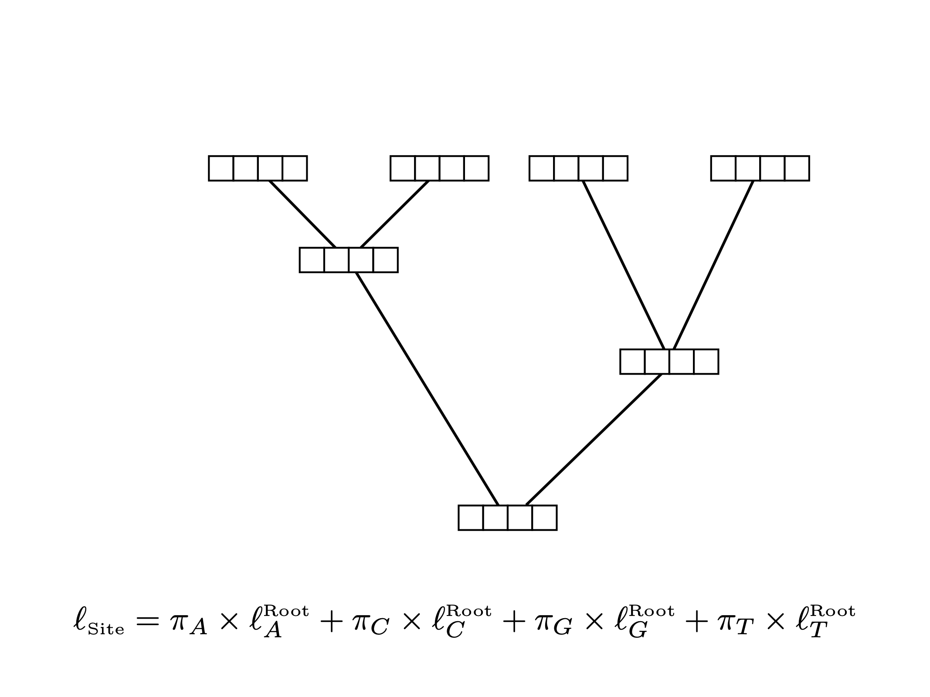
The two great (math) tricks that make it all possible
Problem Two: The number of different possible combinations of states at the internal nodes of a tree of n species is 4^{(n-1).} This is a very big number for any even moderately sized tree! Given that we don’t know what these internal states are, how can we average over all of them?
Trick Two: The pruning algorithm!
Slide courtesy of John Huelsenbeck

Slide 101
The two great (math) tricks that make it all possible
Problem Two: The number of different possible combinations of states at the internal nodes of a tree of n species is 4^{(n-1).} This is a very big number for any even moderately sized tree! Given that we don’t know what these internal states are, how can we average over all of them?
Trick Two: The pruning algorithm!
This gives you the full “site likelihood” (the probably of seeing the data at that particular site given the model).
Slide courtesy of John Huelsenbeck

Slide 102
Example
Learning by simulation
Slide courtesy of John Huelsenbeck

Slide 103
Example
Learning by simulation
Slide courtesy of John Huelsenbeck

Slide 104
Example
Slide courtesy of John Huelsenbeck

Slide 105
Example
Slide courtesy of John Huelsenbeck

Slide 106
Example
Slide courtesy of John Huelsenbeck

Slide 107
Example
Slide courtesy of John Huelsenbeck

Slide 108
Example
Slide courtesy of John Huelsenbeck

Slide 109
Example
Slide courtesy of John Huelsenbeck

Slide 110
Example
Slide courtesy of John Huelsenbeck

Slide 111
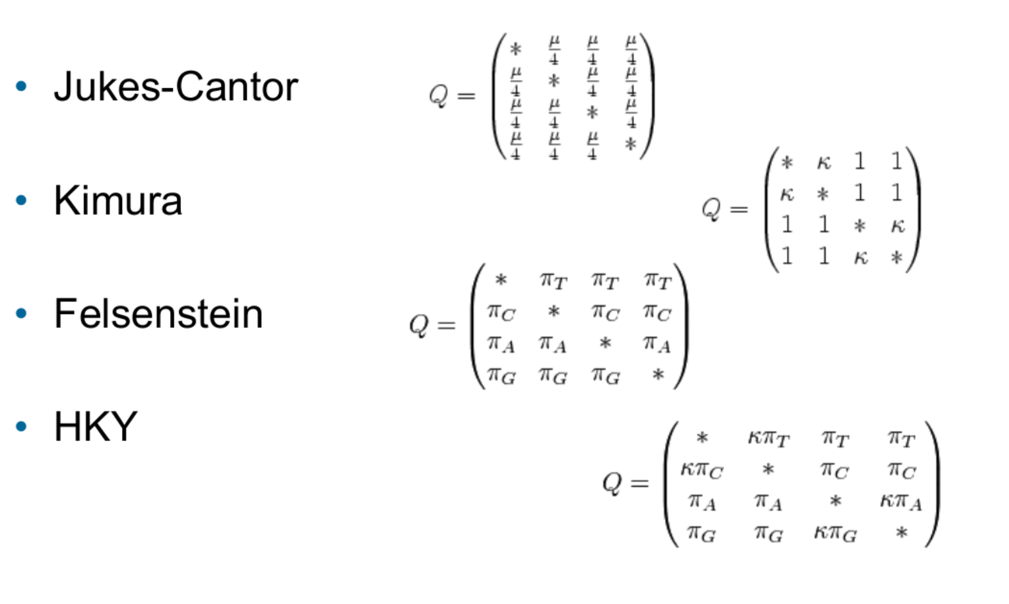
Common models and their Q-matrices
JC: all bases have the same (stationary) frequency and change into each other at equal rates
K80: transitions and transversions can happen at different rates
HKY: transitions and transversions can happen at different rates and the stationary frequencies can be different
Courtesy of web.stanford.edu

Slide 112
Stationary frequencies?
Our handy instantaneous-rate matrix:
Slide courtesy of John Huelsenbeck

Slide 113
Our handy instantaneous-rate matrix:
Stationary frequencies?
Slide courtesy of John Huelsenbeck

Slide 114
Stationary frequencies?
Our handy instantaneous-rate matrix:
Slide courtesy of John Huelsenbeck

Slide 115
Stationary frequencies?
Our handy instantaneous-rate matrix:
Slide courtesy of John Huelsenbeck

Slide 116
Stationary frequencies?
Our handy instantaneous-rate matrix:
Slide courtesy of John Huelsenbeck

Slide 117
Stationary frequencies?
Our handy instantaneous-rate matrix:
Slide courtesy of John Huelsenbeck

Slide 118
Stationary frequencies?
Our handy instantaneous-rate matrix:
Slide courtesy of John Huelsenbeck

Slide 119
Stationary frequencies?
Our handy instantaneous-rate matrix:
Slide courtesy of John Huelsenbeck

Slide 120
Stationary frequencies?
Slide courtesy of John Huelsenbeck

Slide 121
Stationary frequencies?
Slide courtesy of John Huelsenbeck

Slide 122
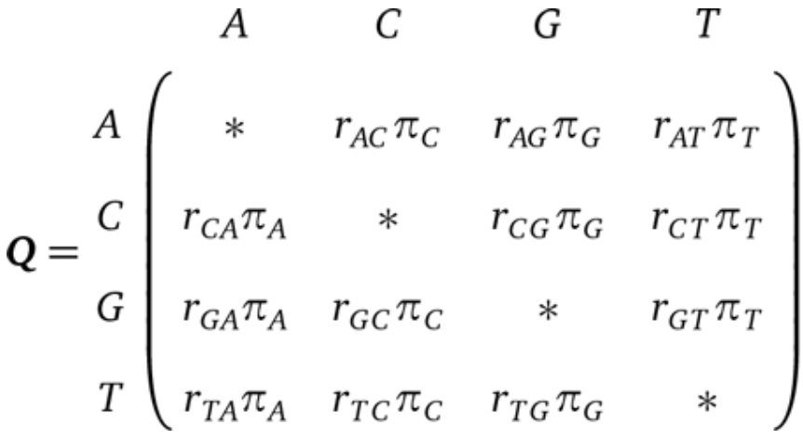
Substitution models
We often split our instantaneous rates into a portion due to the stationary frequencies (pi’s) and a portion due to the “exchangeability” rates
The general time-reversable model (GTR) gives each of these components its own parameter:

